Slide 1
Deep Learning
Outline:
Neural networks
Convolutional Neural Networks
Deep Generative Learning

Slide 2
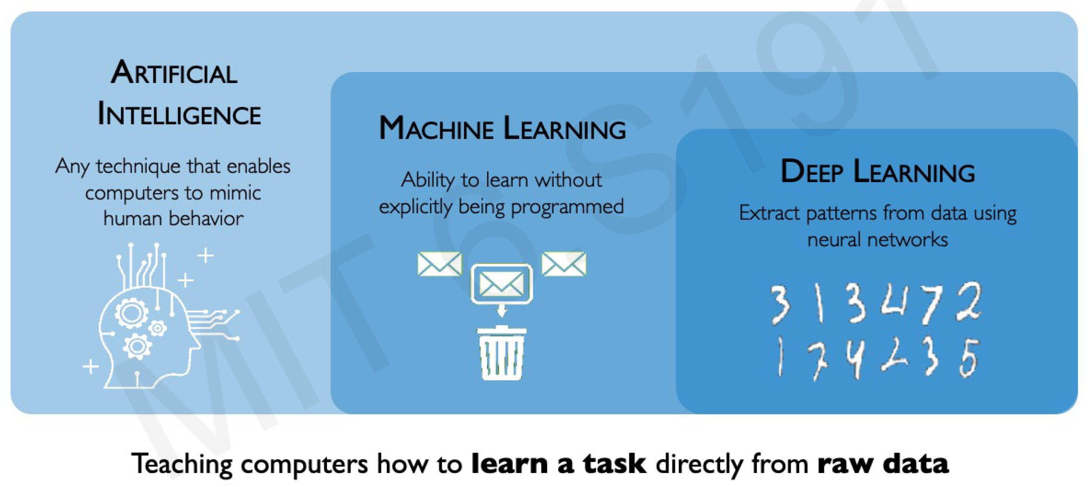
What is Deep Learning?

Slide 3
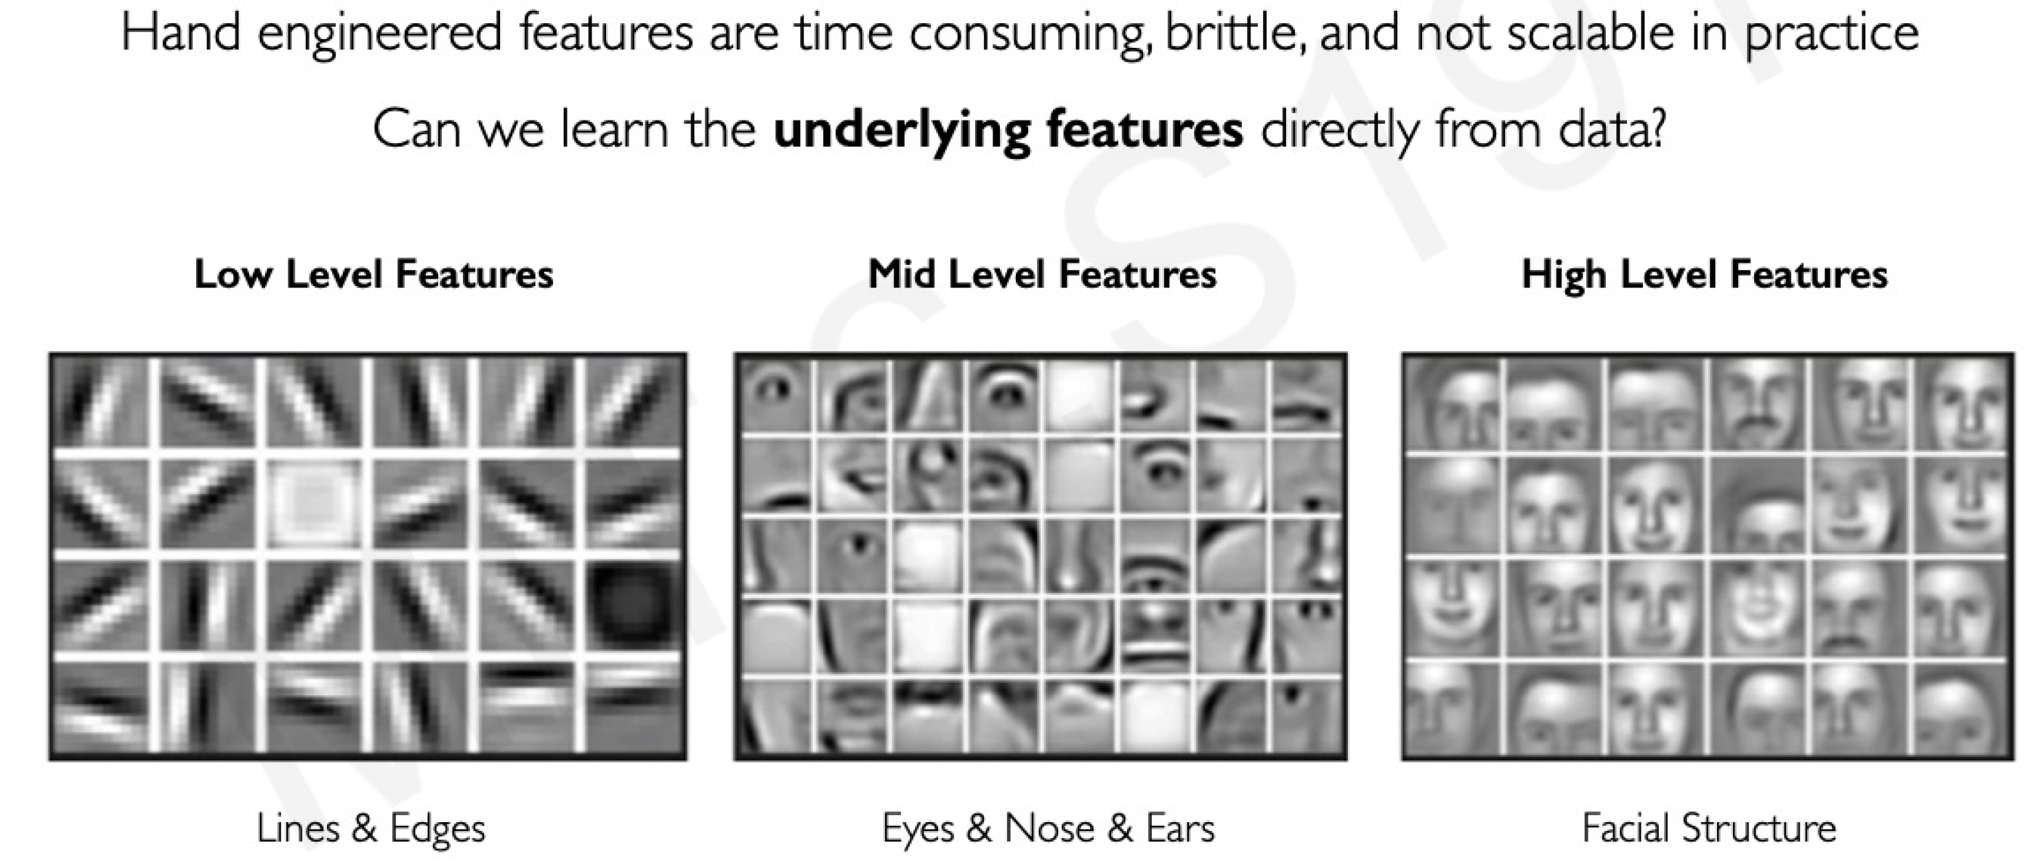
Why Deep Learning?

Slide 4
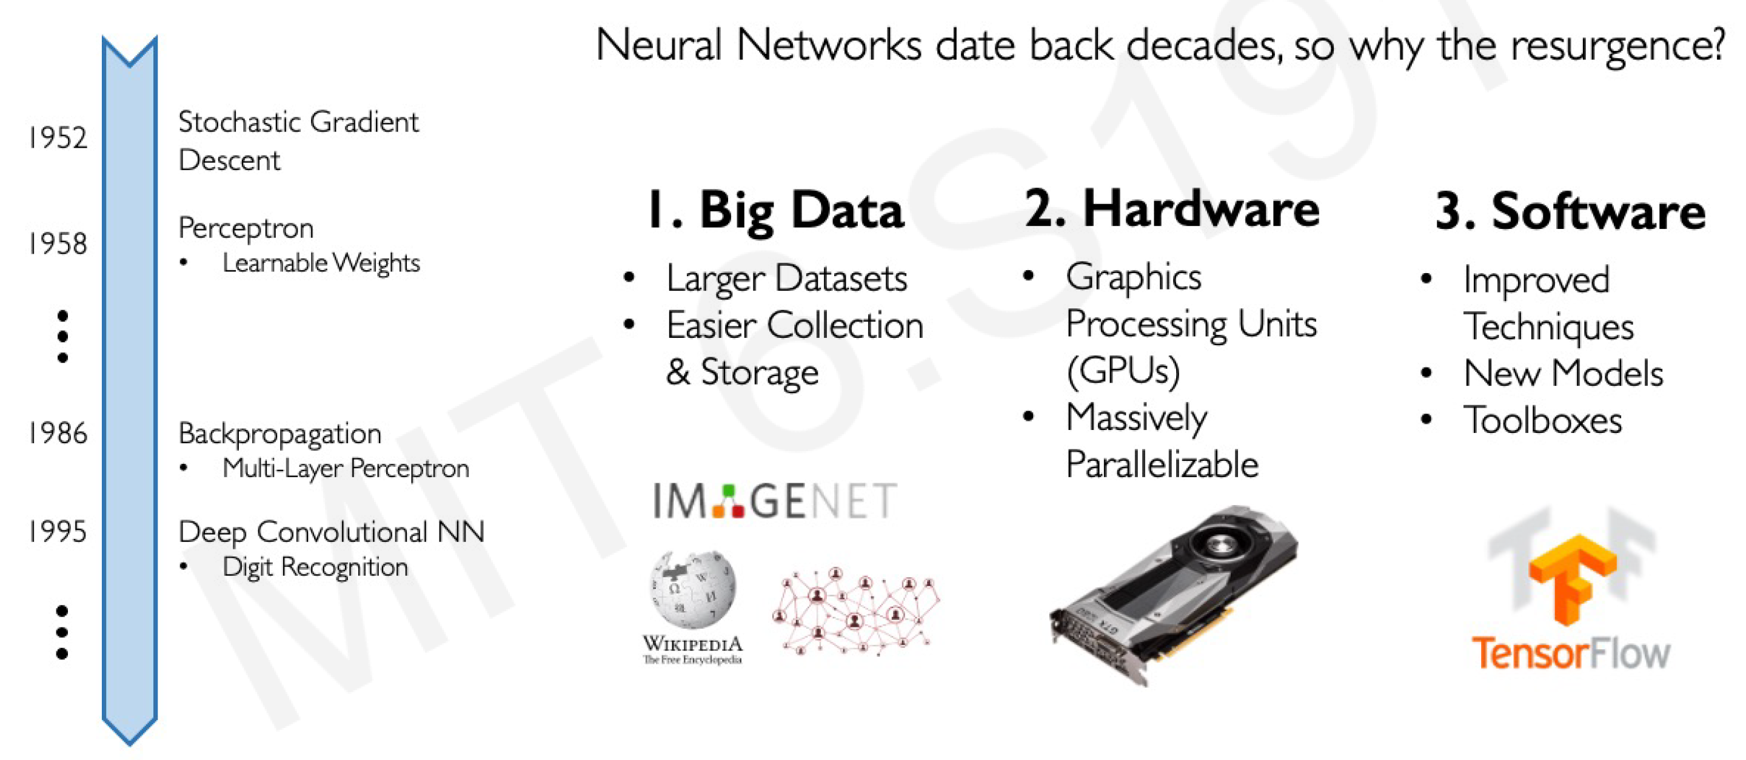
Why Now?

Slide 5
The Perceptron
The structural building block of deep learning

Slide 6
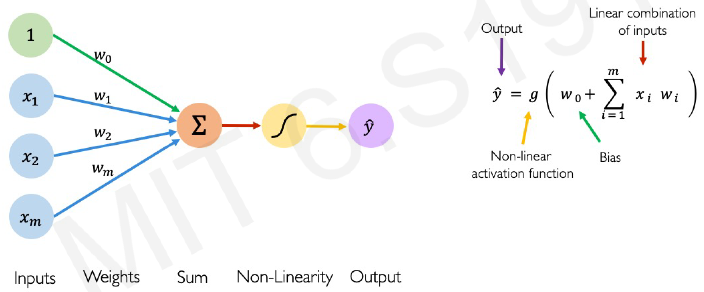
The Perceptron: Forward Propagation

Slide 7
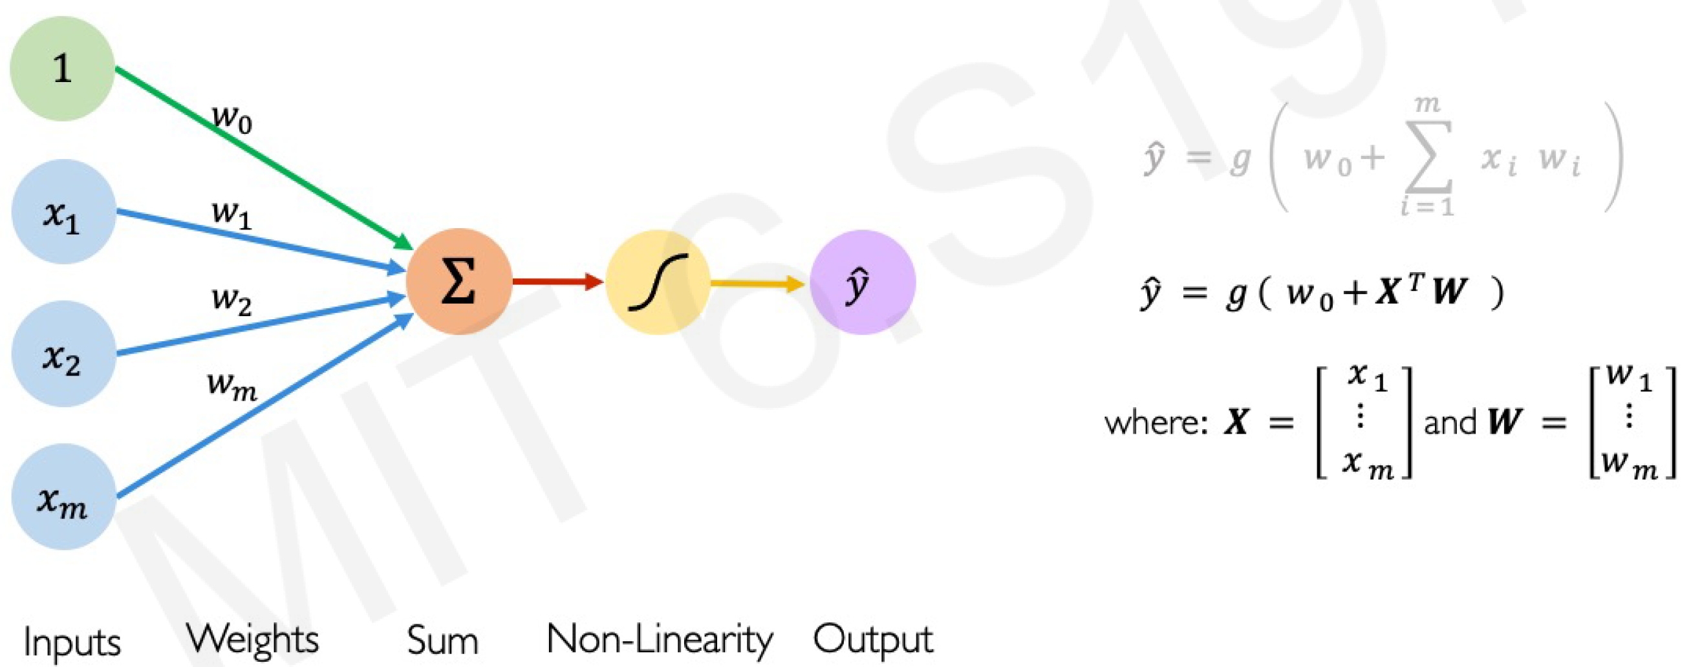
The Perceptron: Forward Propagation

Slide 8
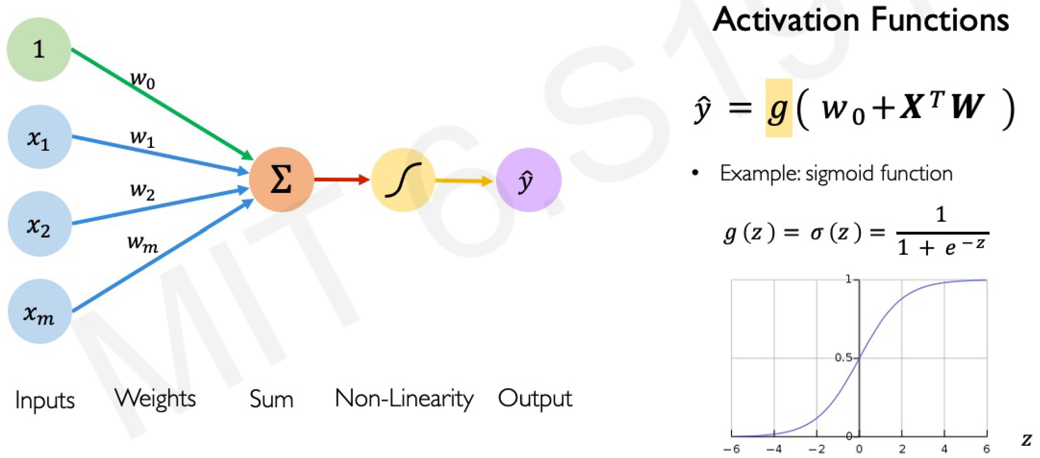
The Perceptron: Forward Propagation

Slide 9
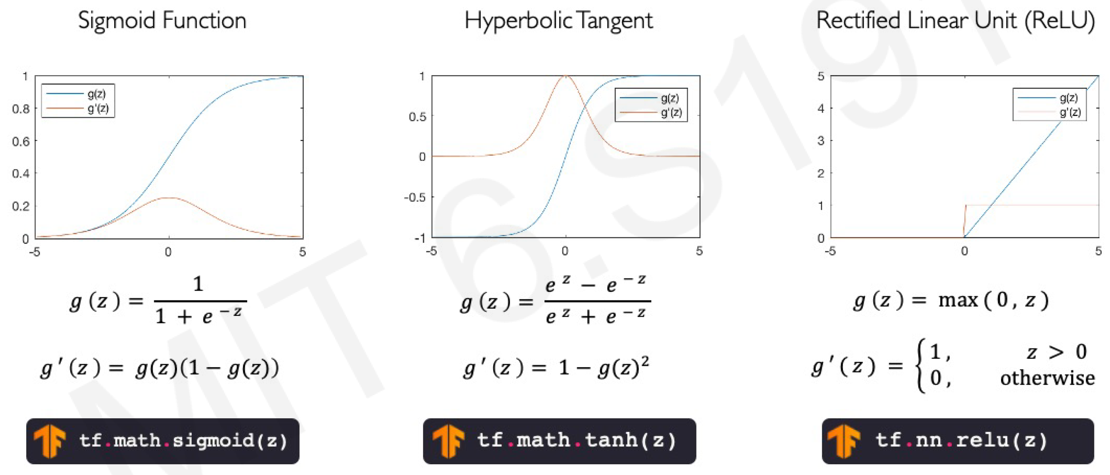
Common Activation Functions

Slide 10
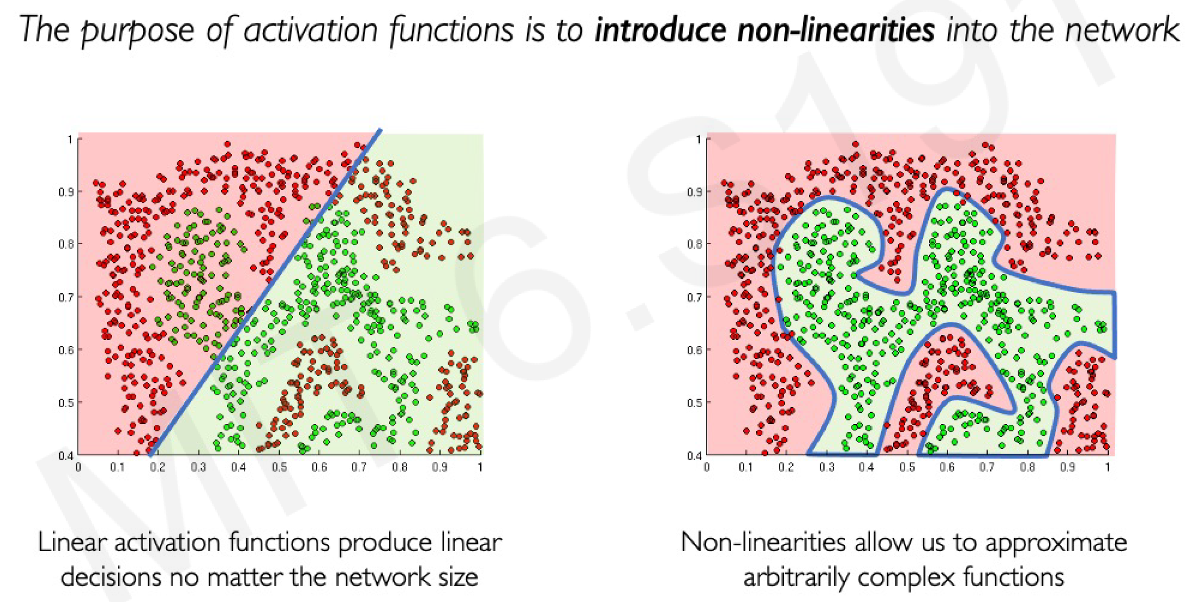
Importance of Activation Functions

Slide 11
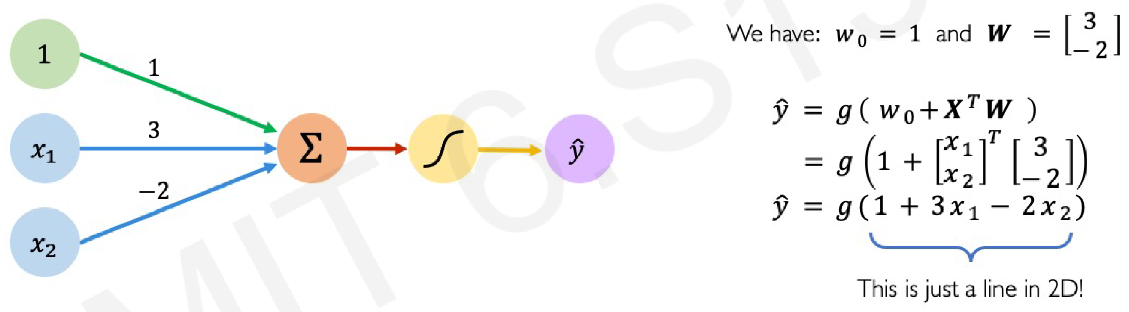
The Perceptron: Example

Slide 12
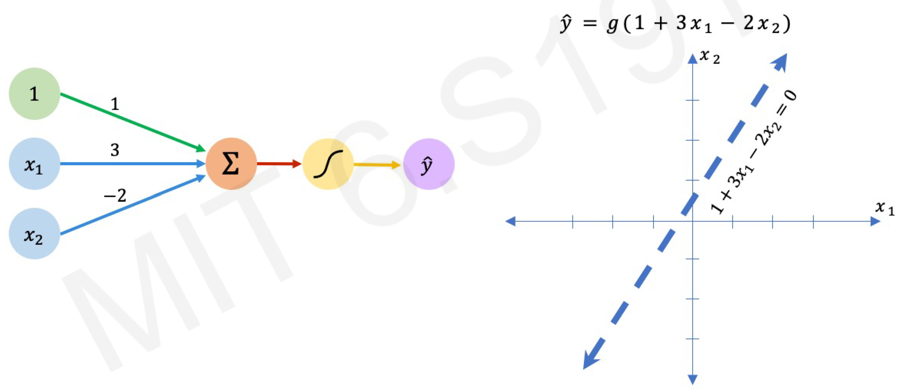
The Perceptron: Example

Slide 13
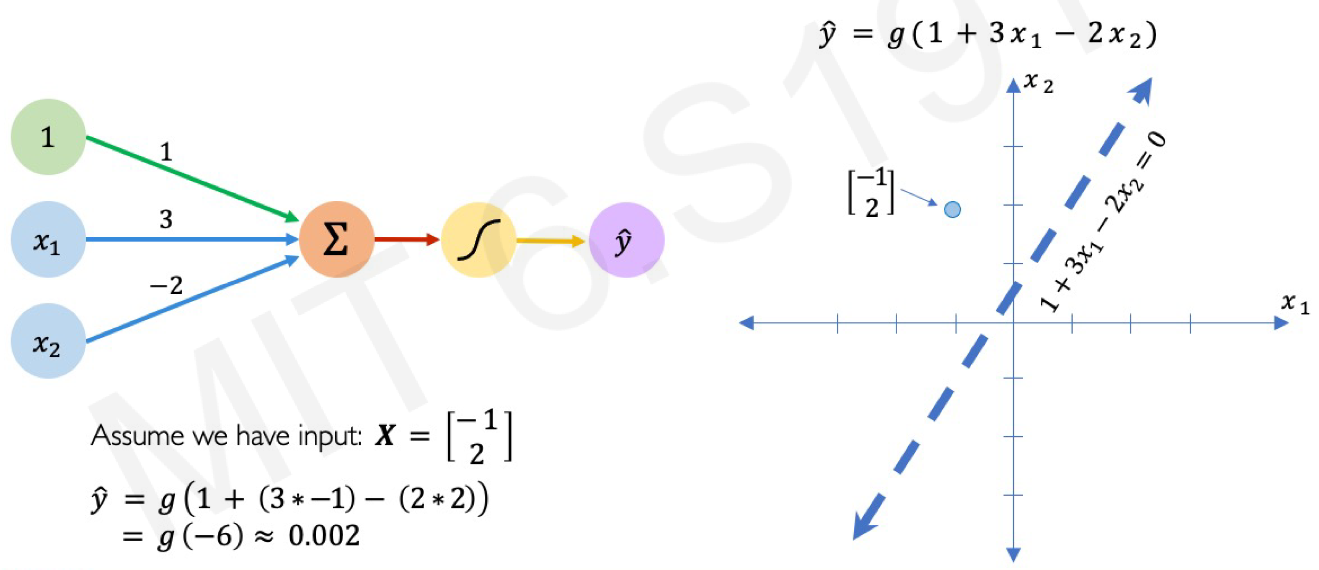
The Perceptron: Example

Slide 14
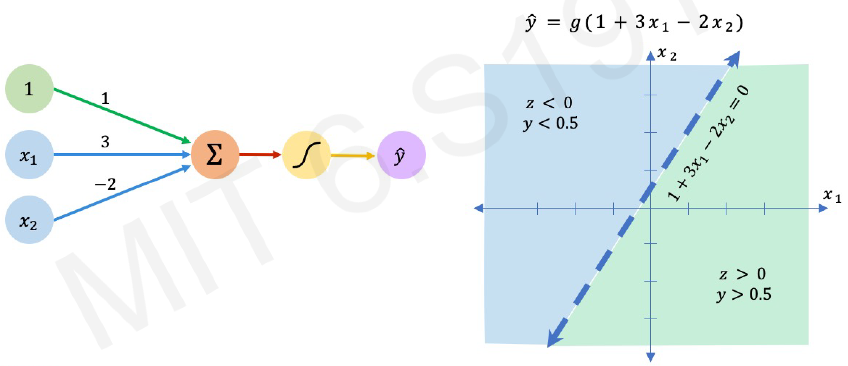
The Perceptron: Example

Slide 15
Building Neural Networks with Perceptrons

Slide 16
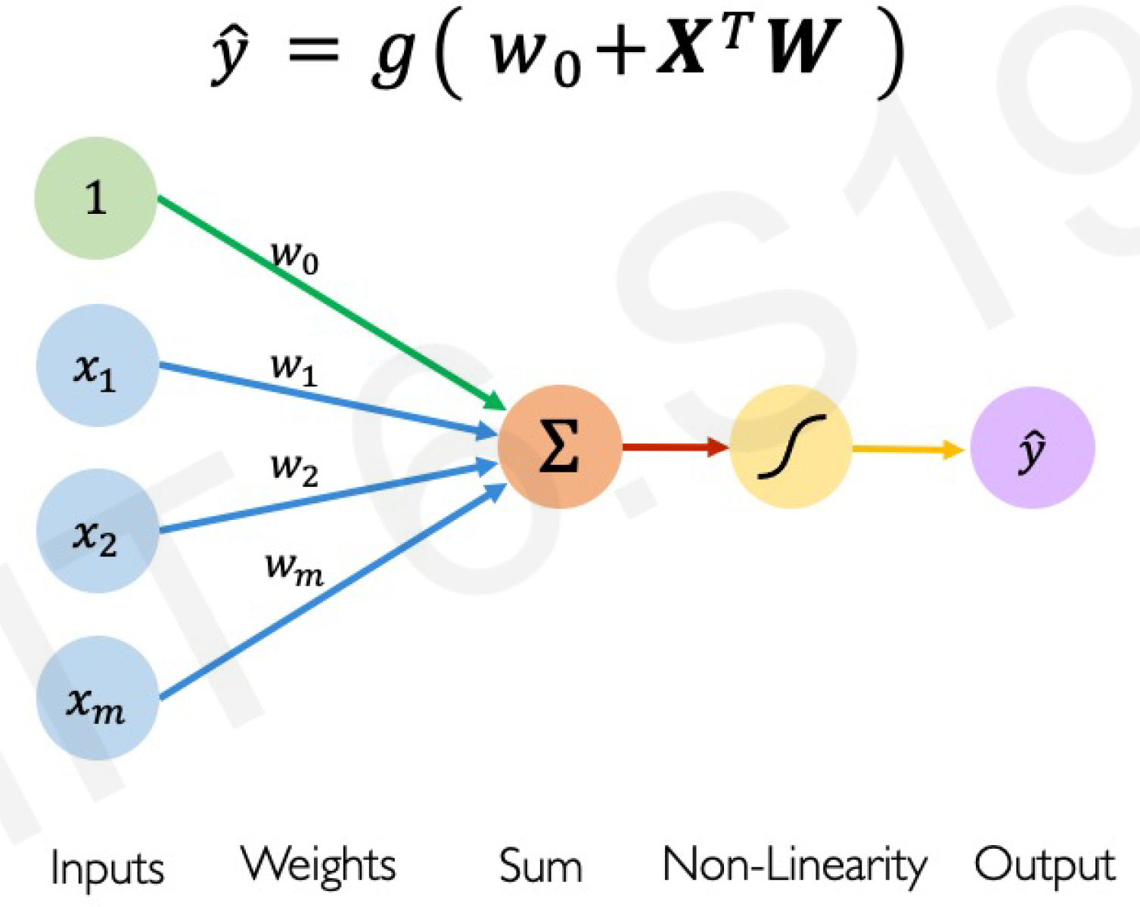
The Perceptron Simplified

Slide 17
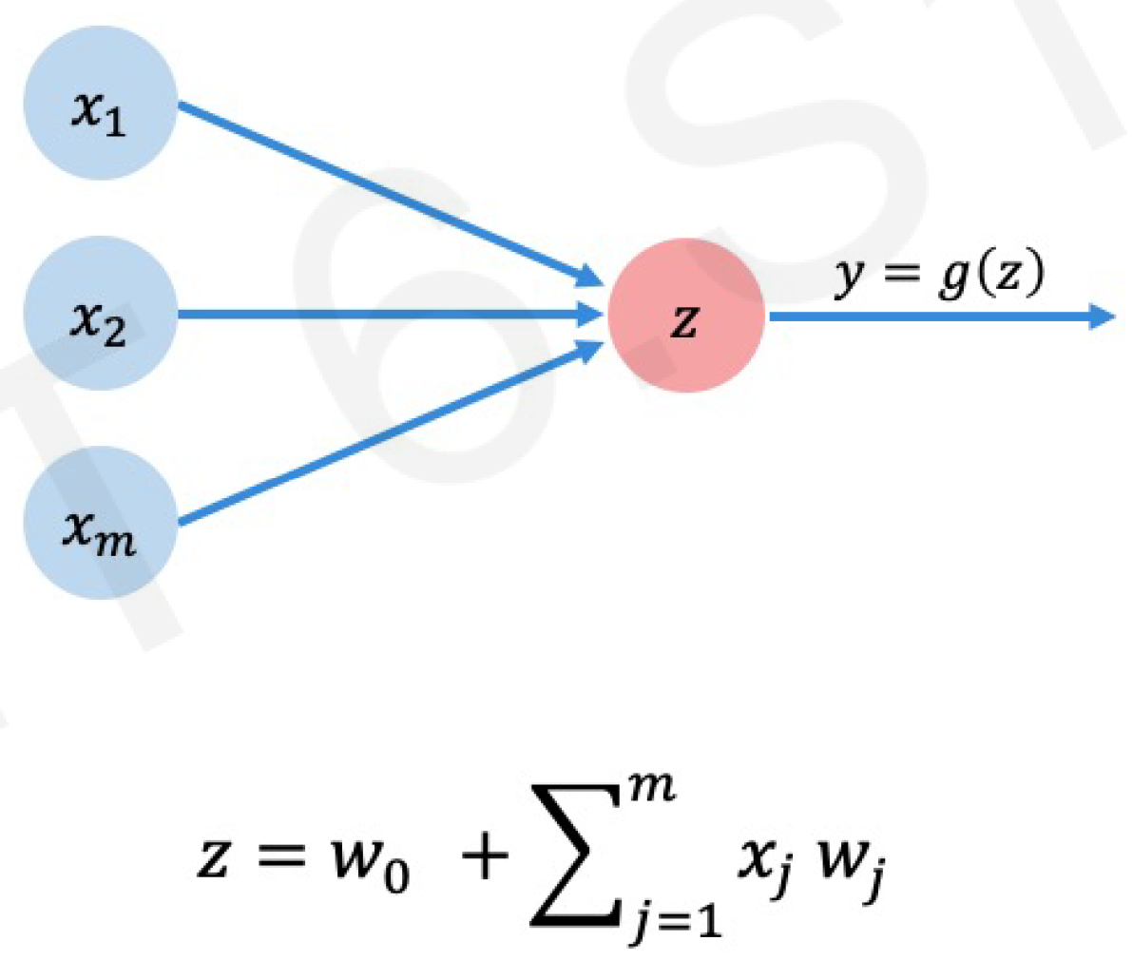
The Perceptron Simplified

Slide 18
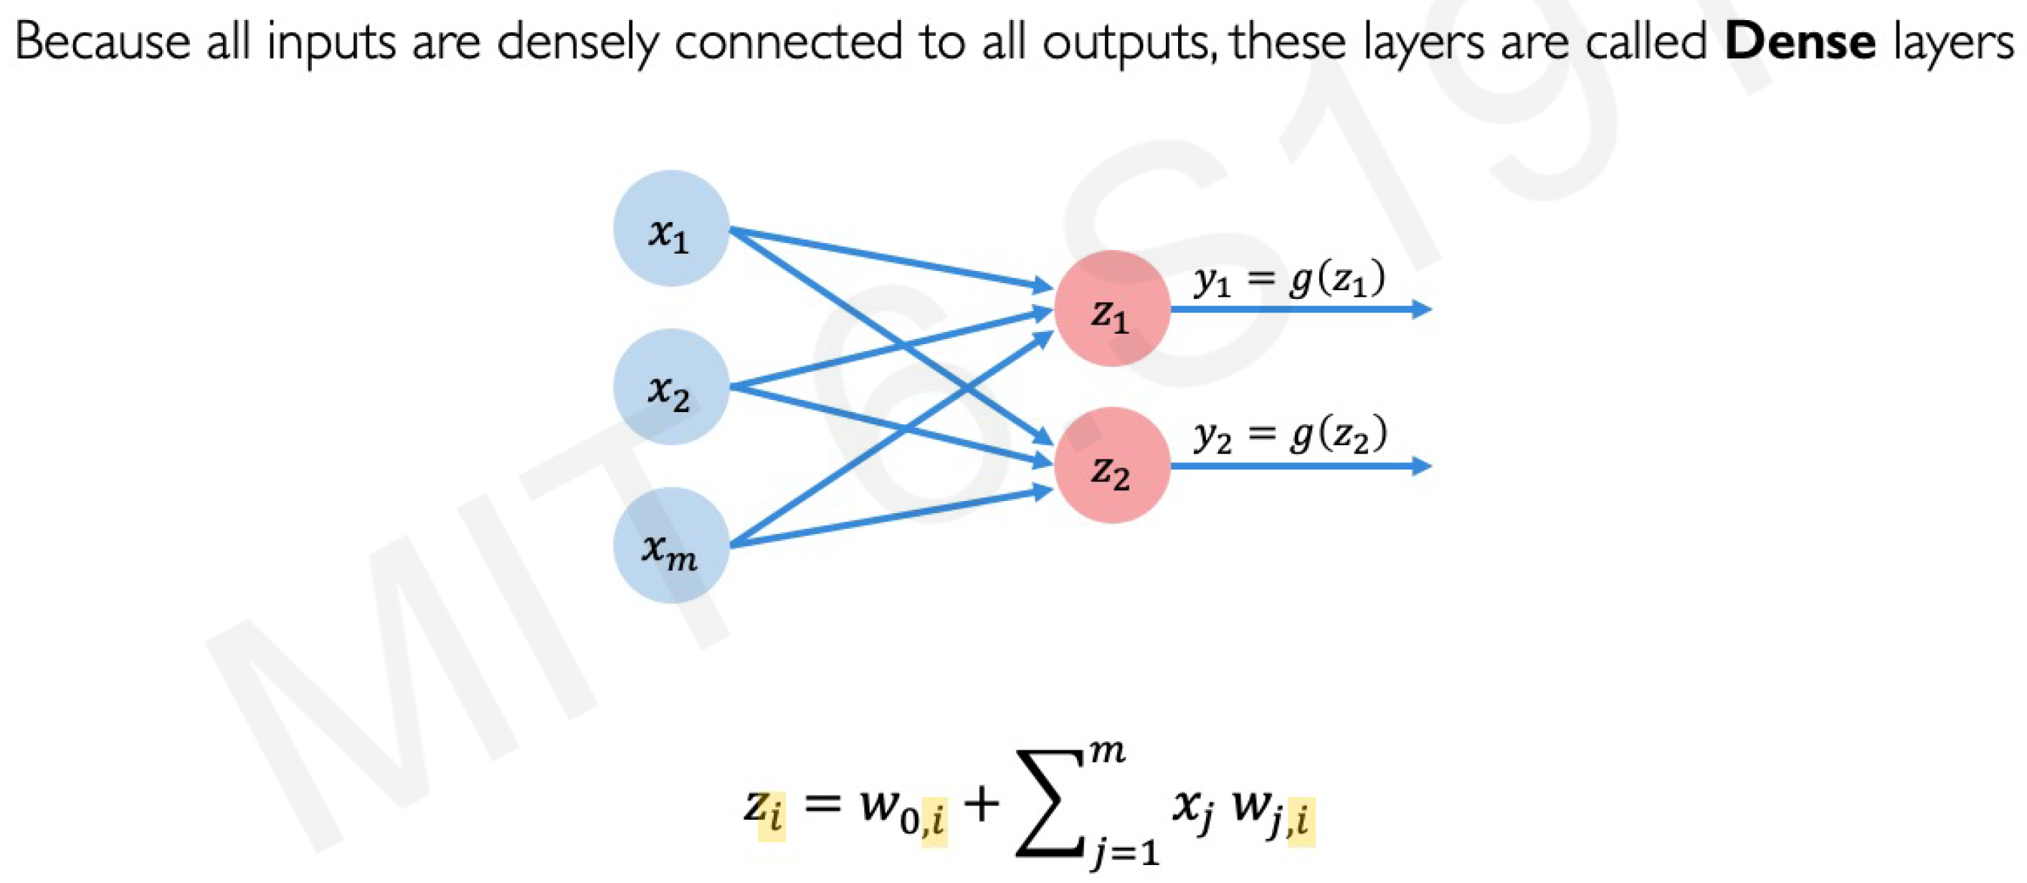
Multi Output Perceptron

Slide 19
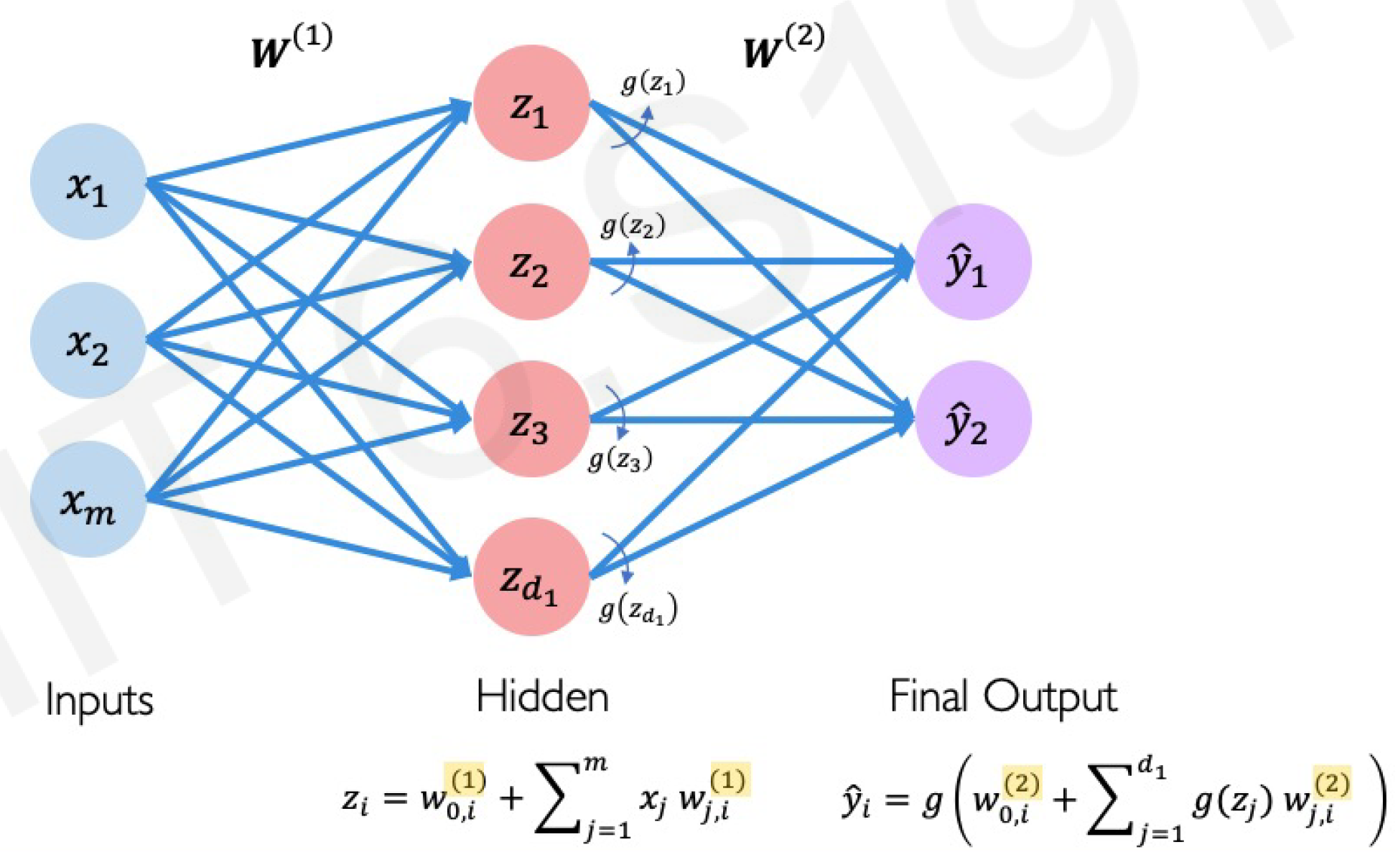
Single Layer Neural Network

Slide 20
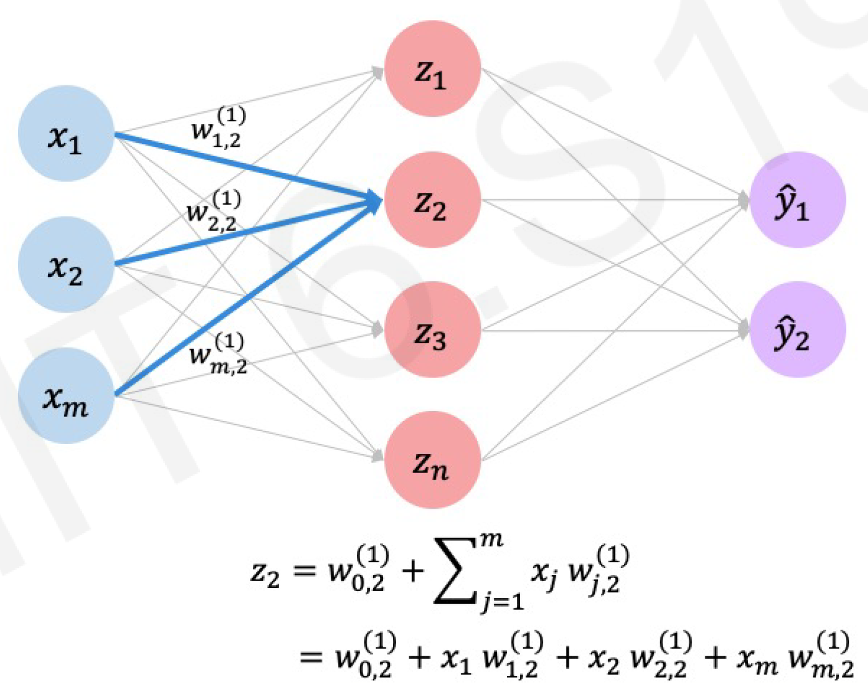
Single Layer Neural Network

Slide 21
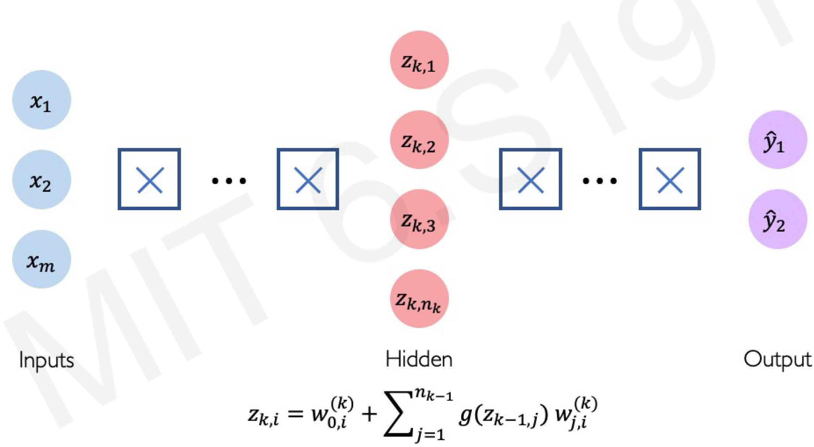
Deep Neural Network

Slide 22
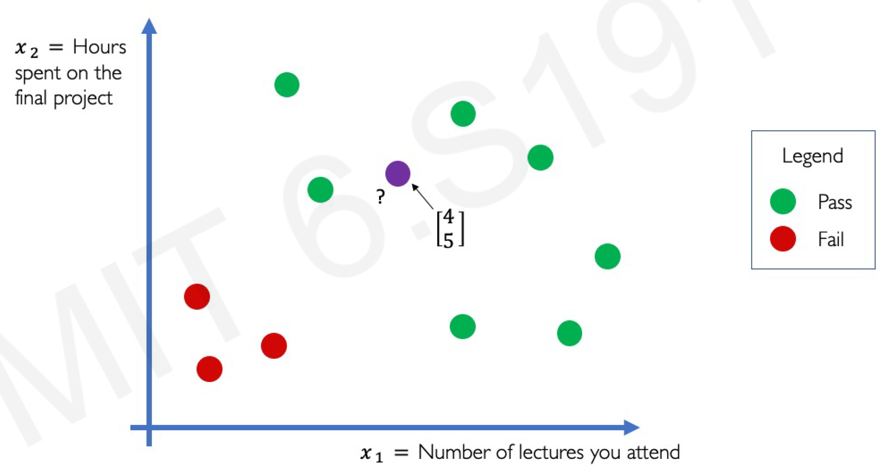
Example Problem: Will I Pass This Class?

Slide 23
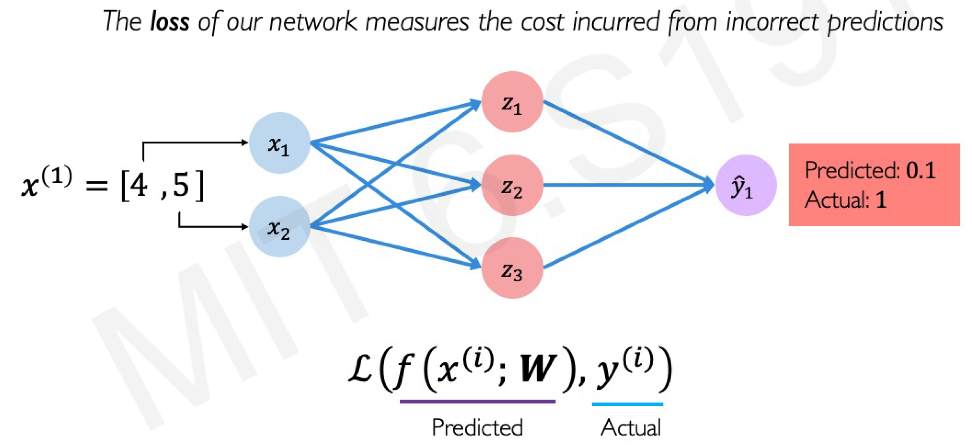
Example Problem: Will I Pass This Class?

Slide 24
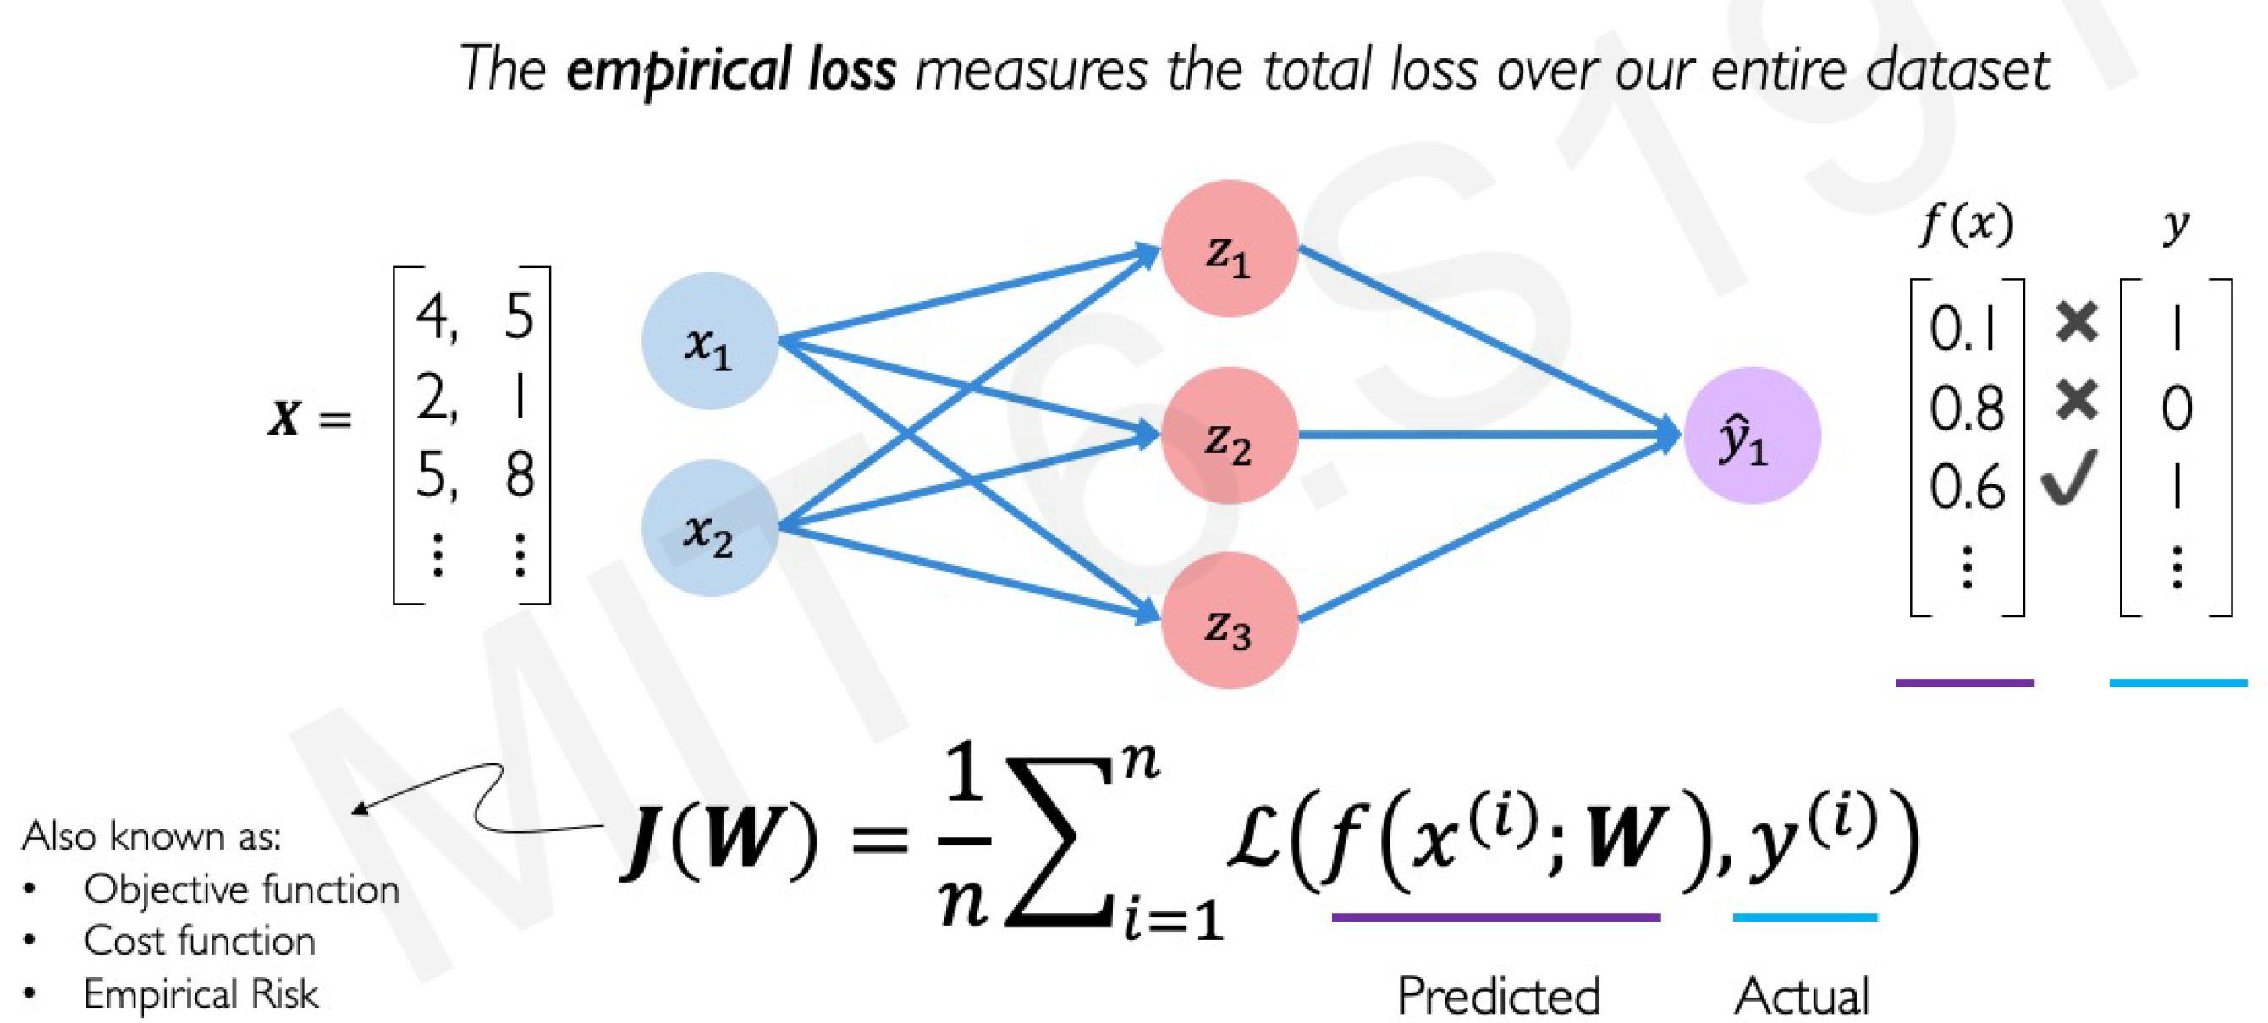
Empirical Loss

Slide 25
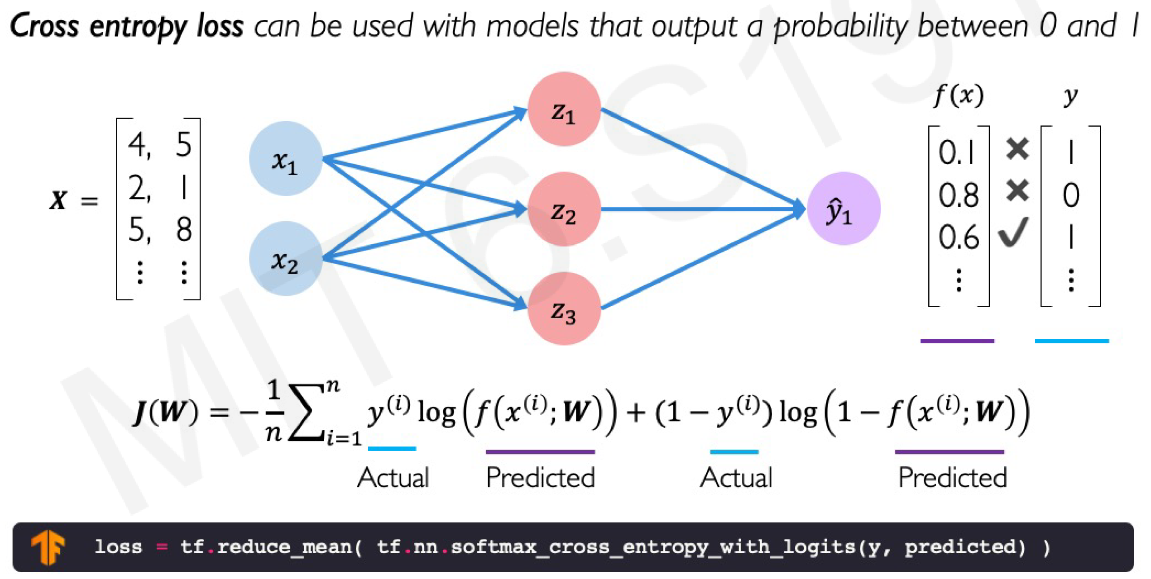
Binary Cross Entropy Loss

Slide 26
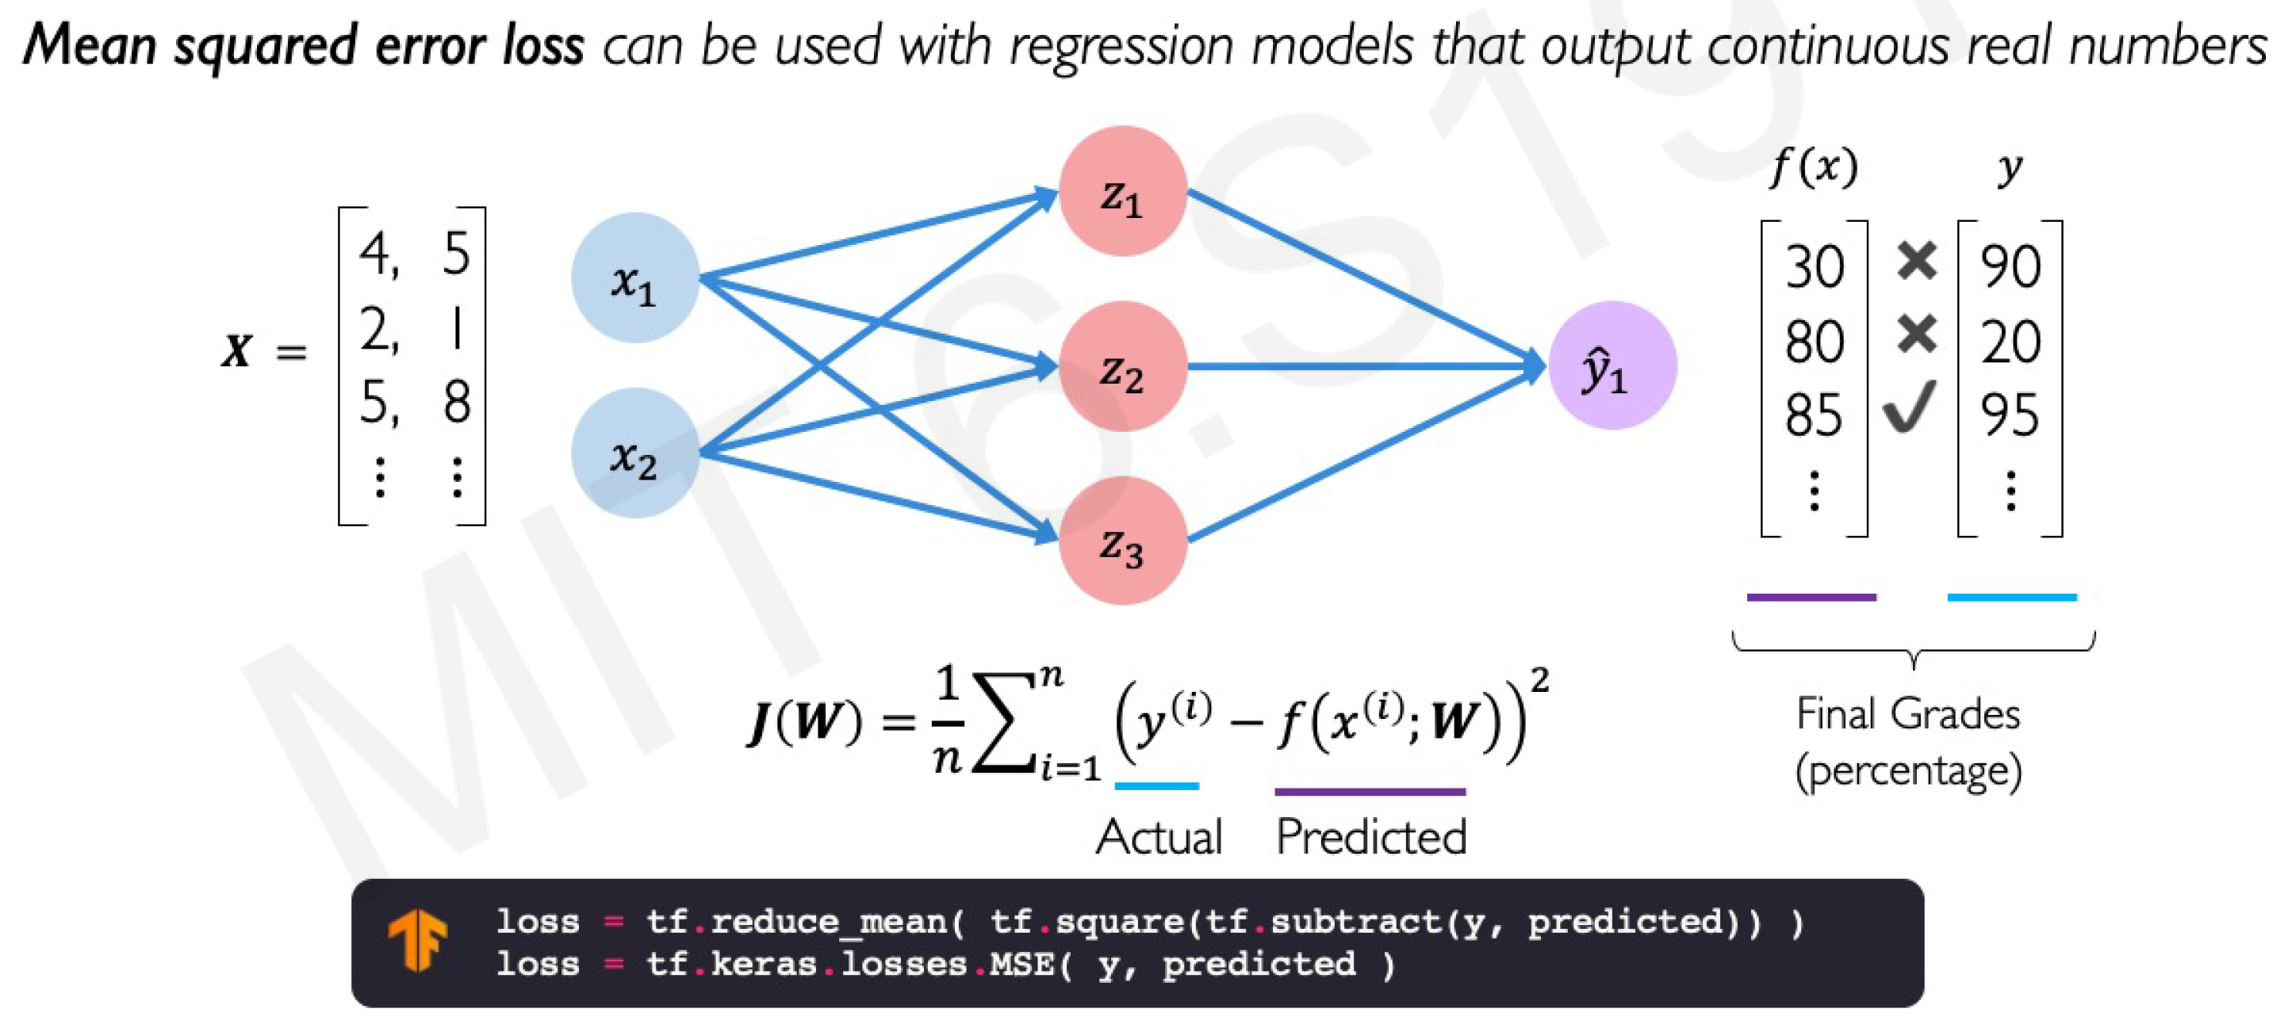
Mean Squared Error Loss

Slide 27
Training Neural Networks

Slide 28
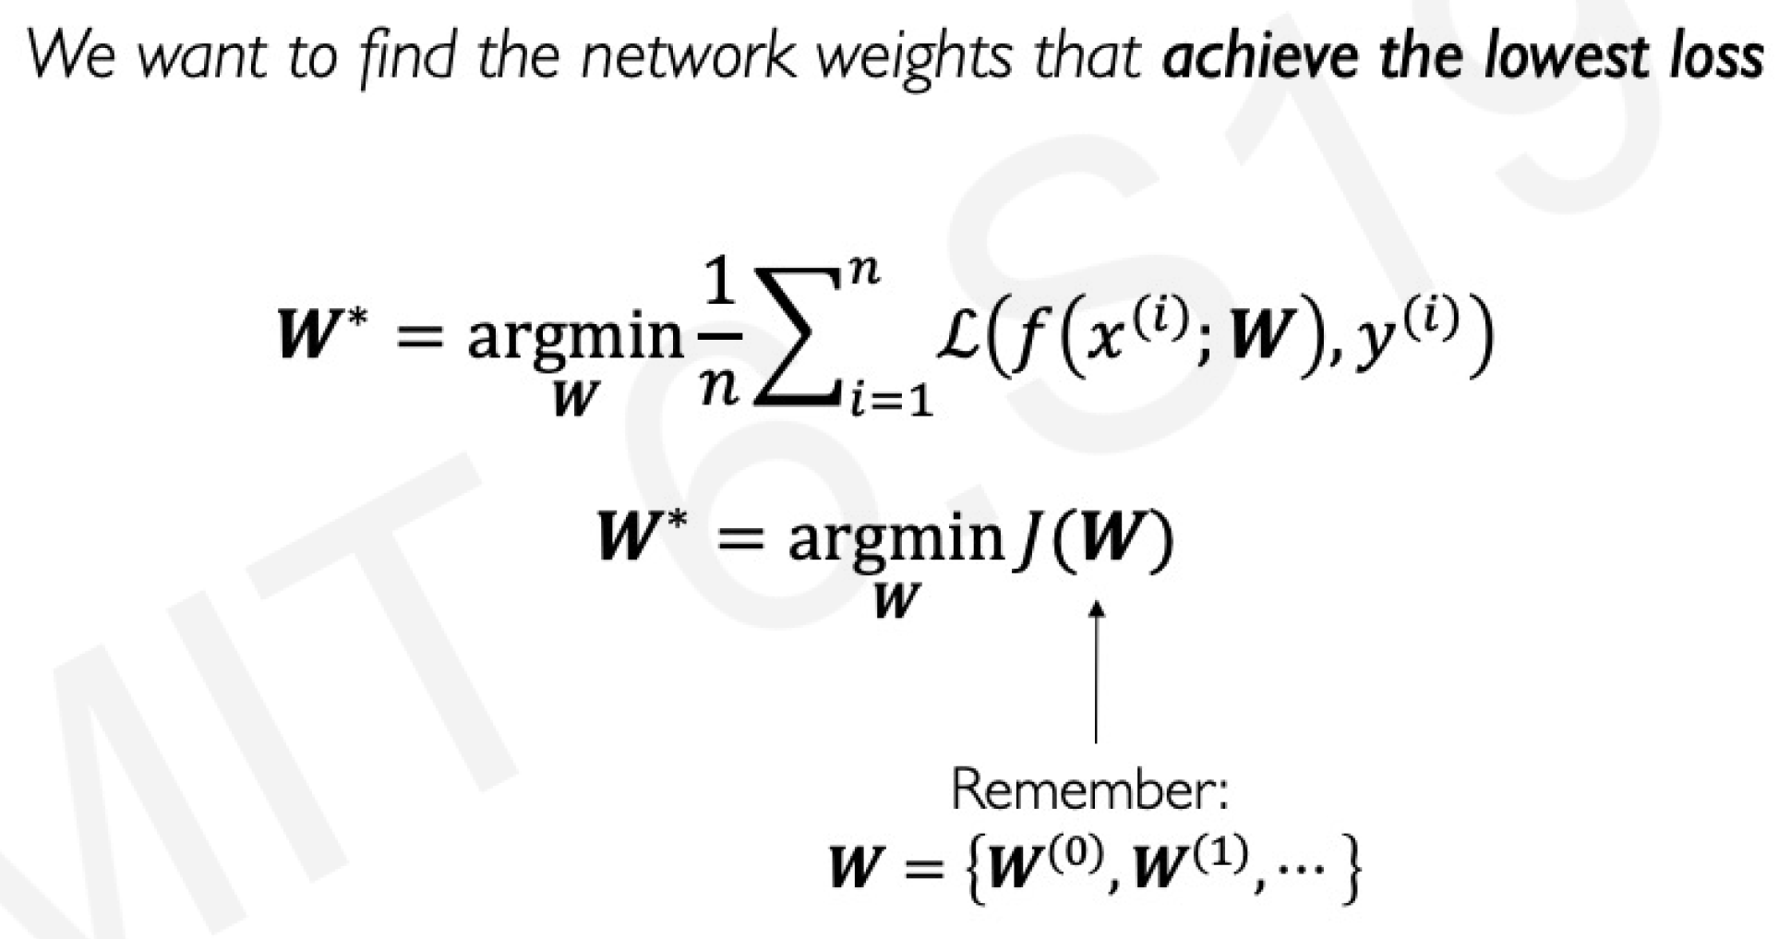
Loss Optimization

Slide 29
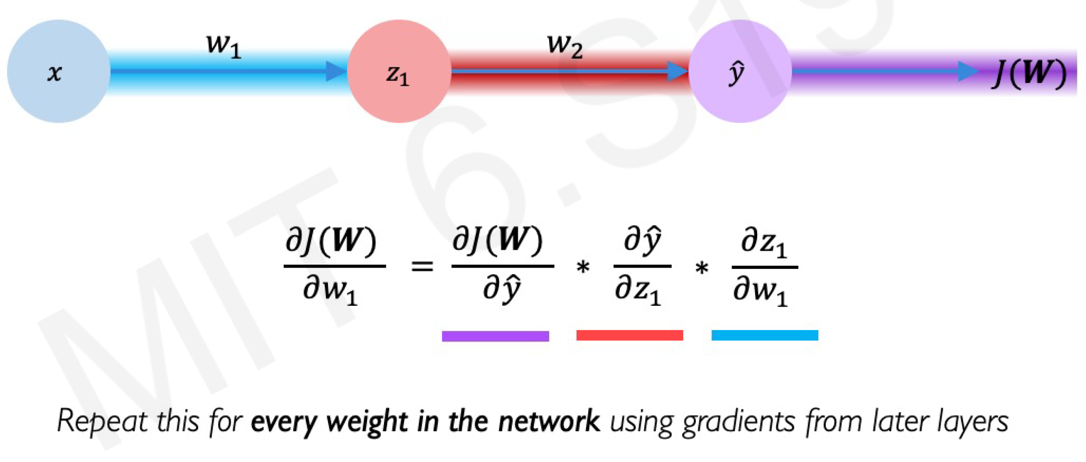
Computing Gradients: Backpropagation

Slide 30
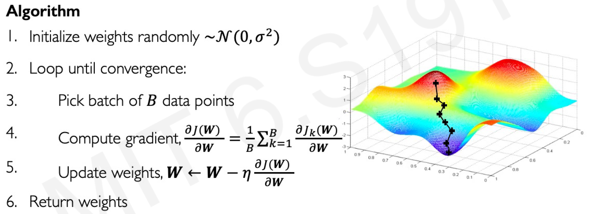
Stochastic Gradient Descent

Slide 31
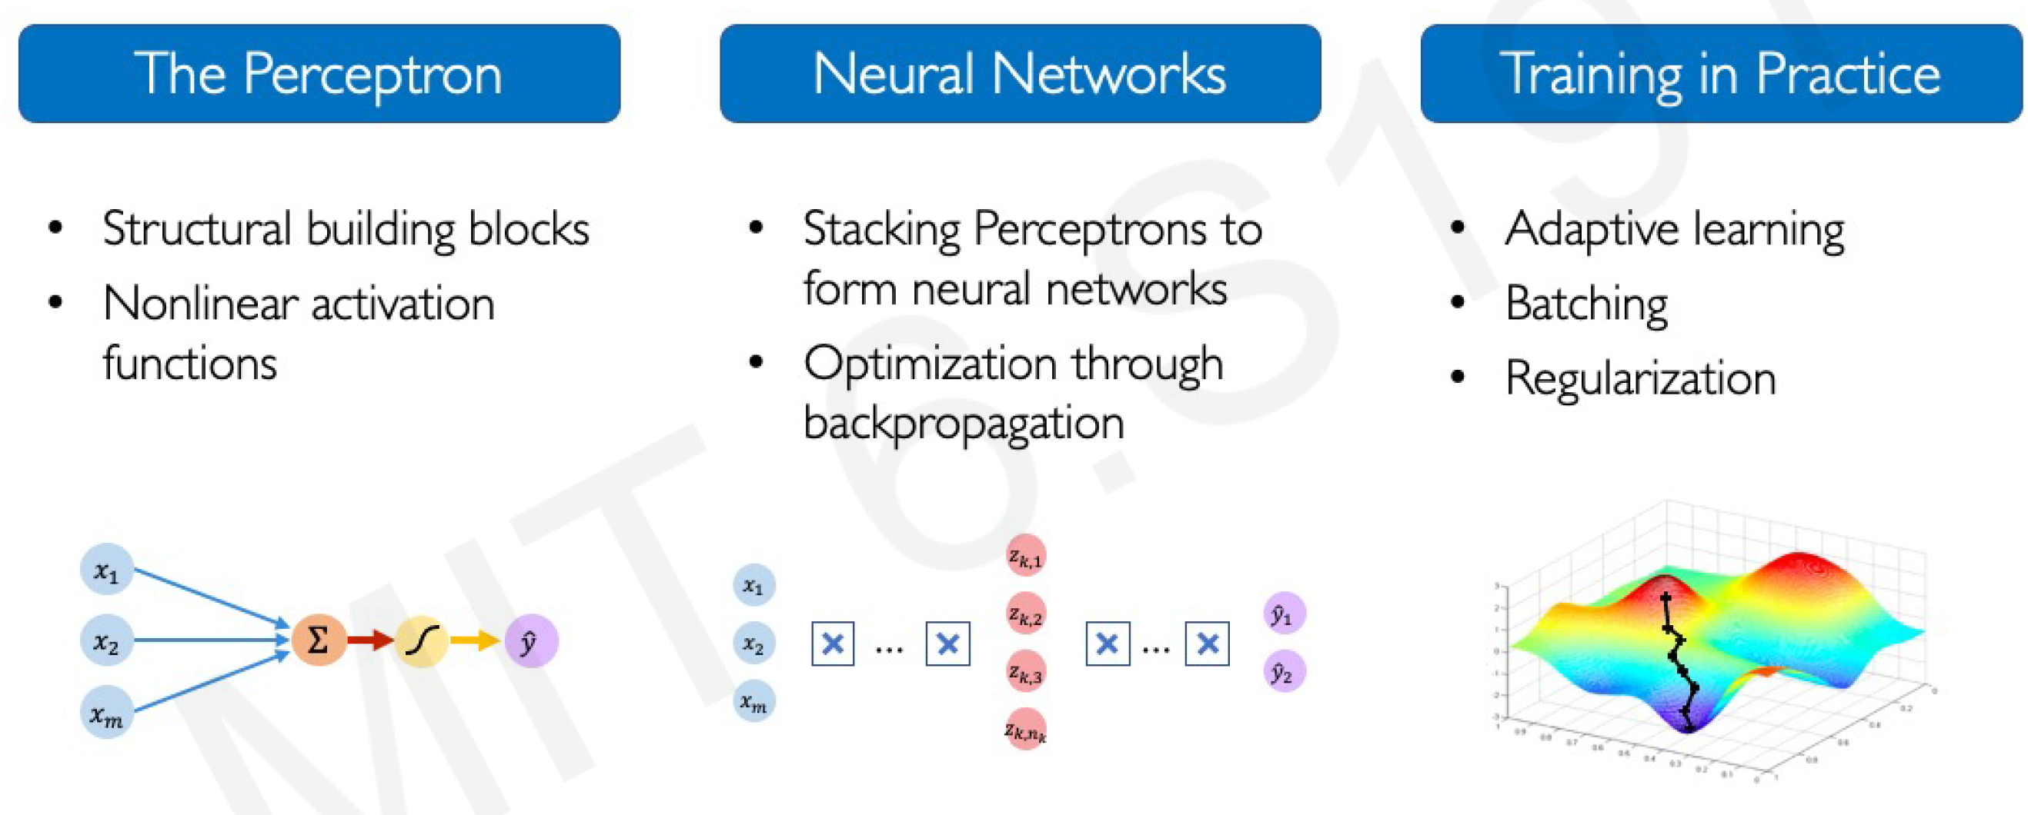
Neural Networks Summary

Slide 32
Deep Learning for Computer Vision

Slide 33
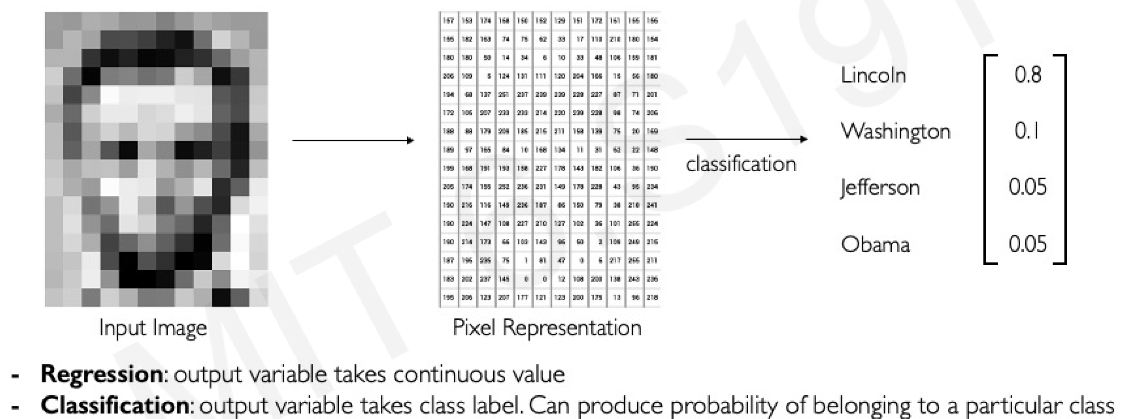
Tasks in Computer Vision

Slide 34
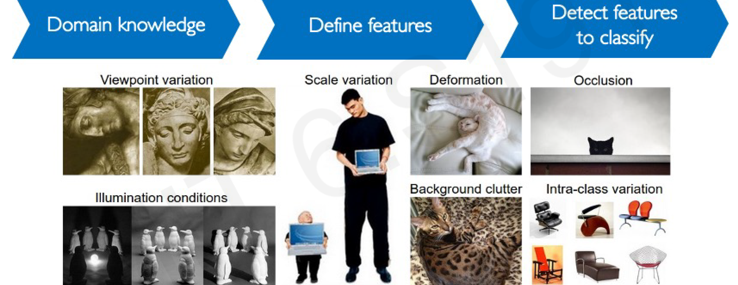
Manual Feature Extraction

Slide 35
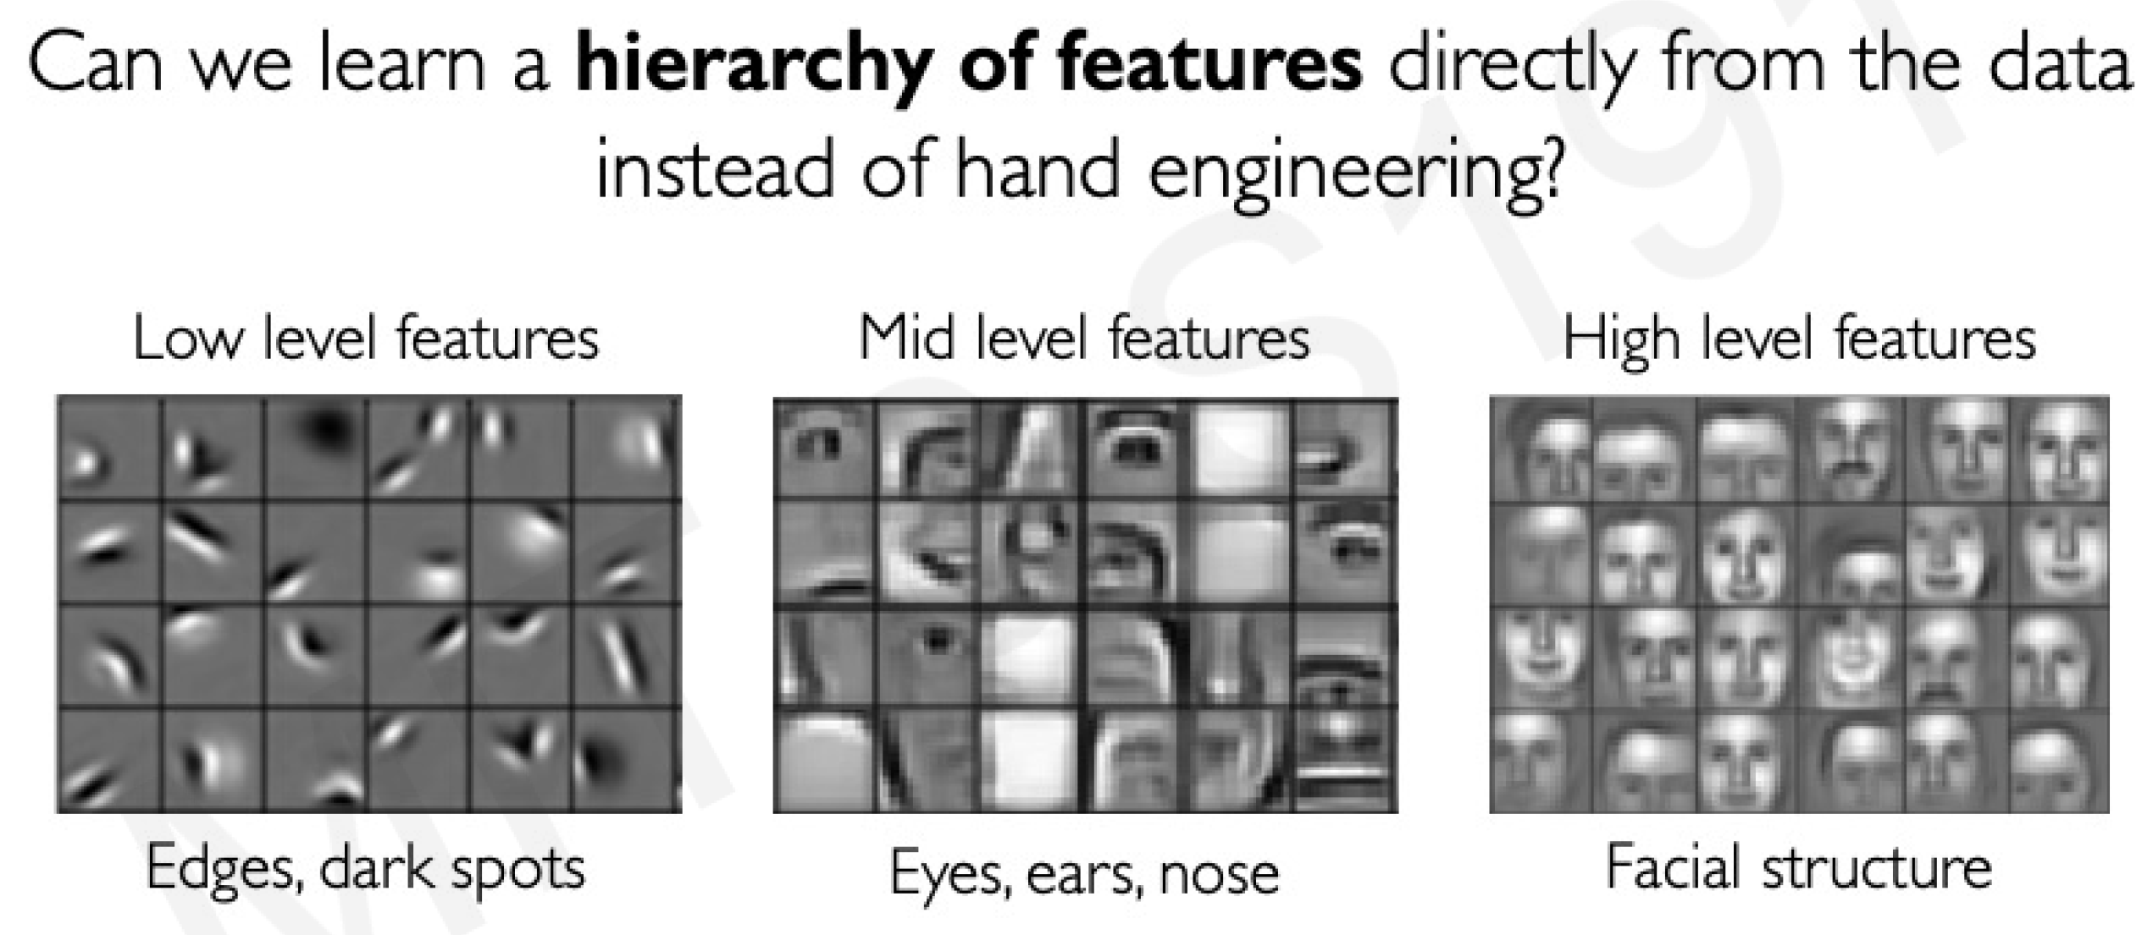
Learning Feature Representations

Slide 36
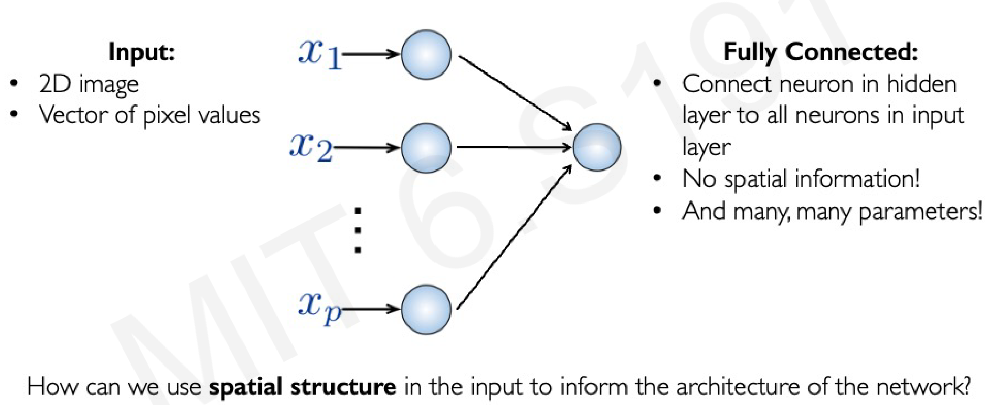
Fully Connected Neural Network

Slide 37
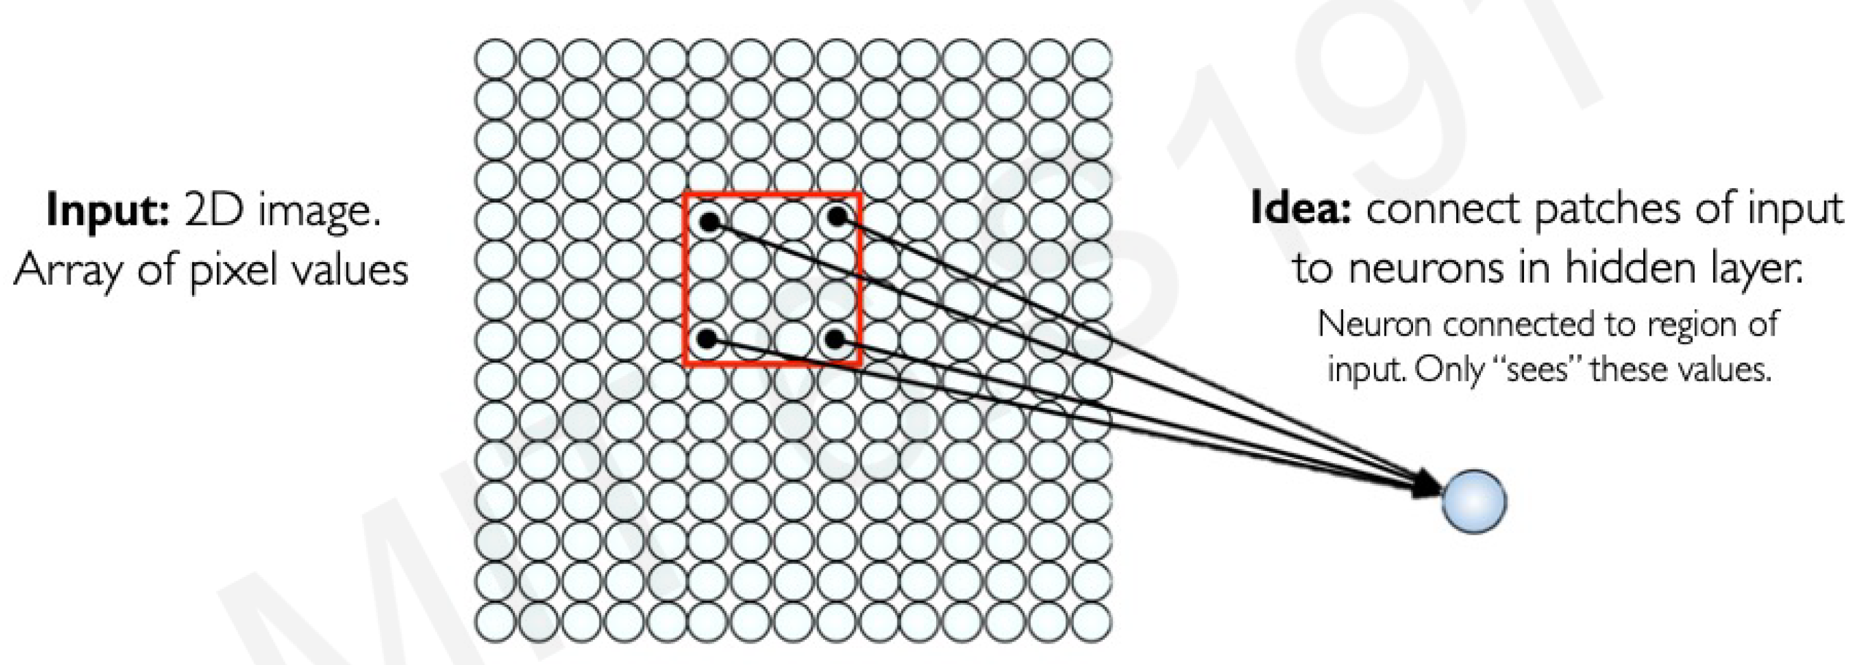
Using Spatial Structure

Slide 38
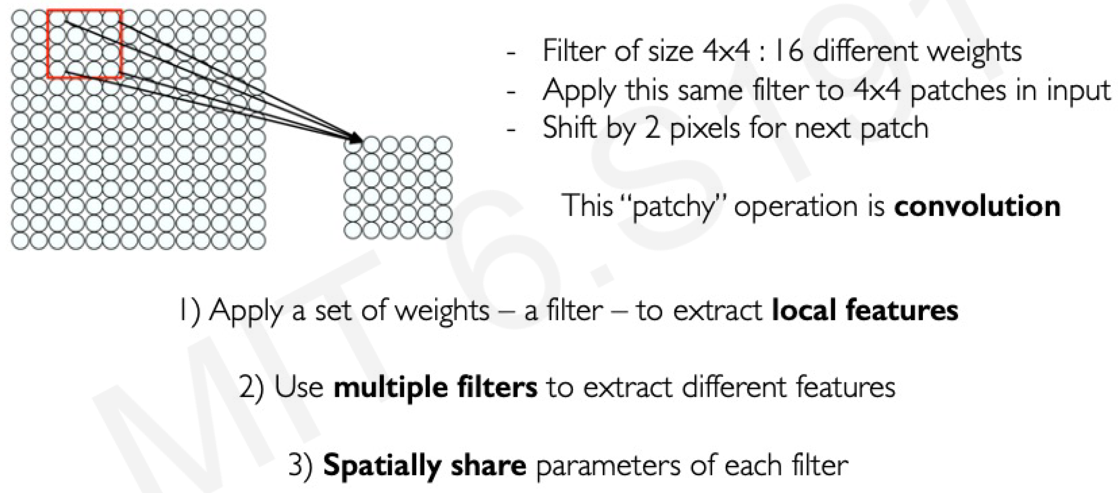
Feature Extraction with Convolution

Slide 39

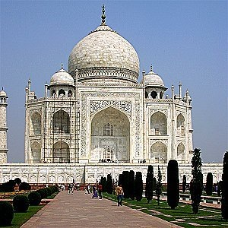
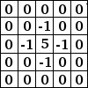


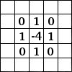
39
Convolutional Neural Networks
sharpen
detect edges
http://www.wildml.com/2015/11/understanding-convolutional-neural-networks-for-nlp/

Slide 40
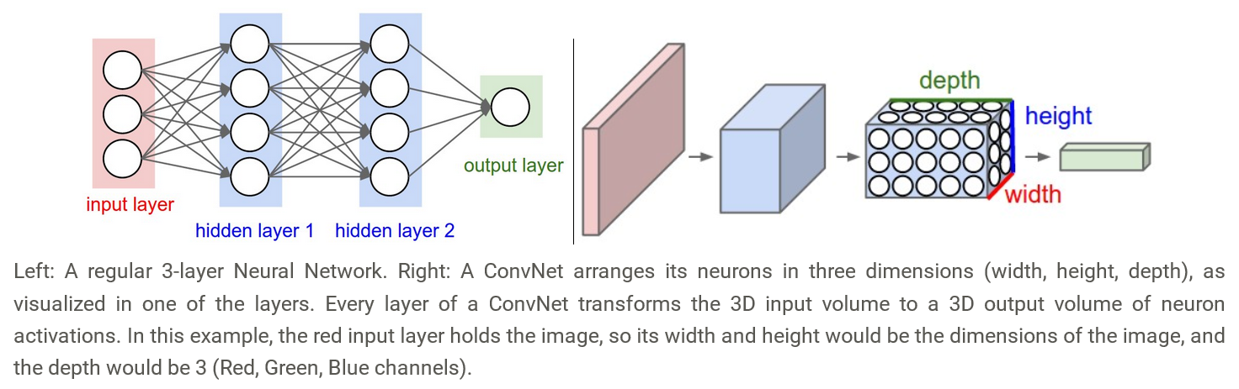
Convolutional Neural Networks
http://cs231n.github.io/convolutional-networks/

Slide 41
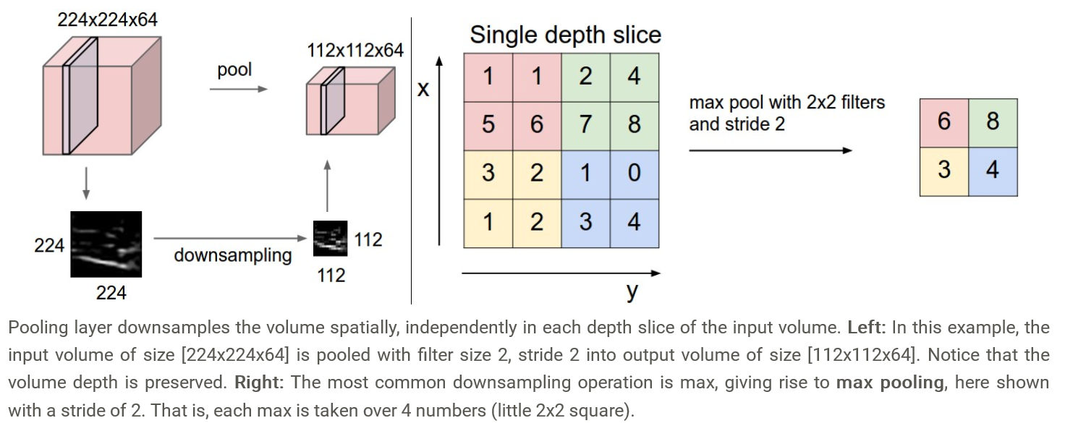
Convolutional Neural Networks
http://cs231n.github.io/convolutional-networks/

Slide 42
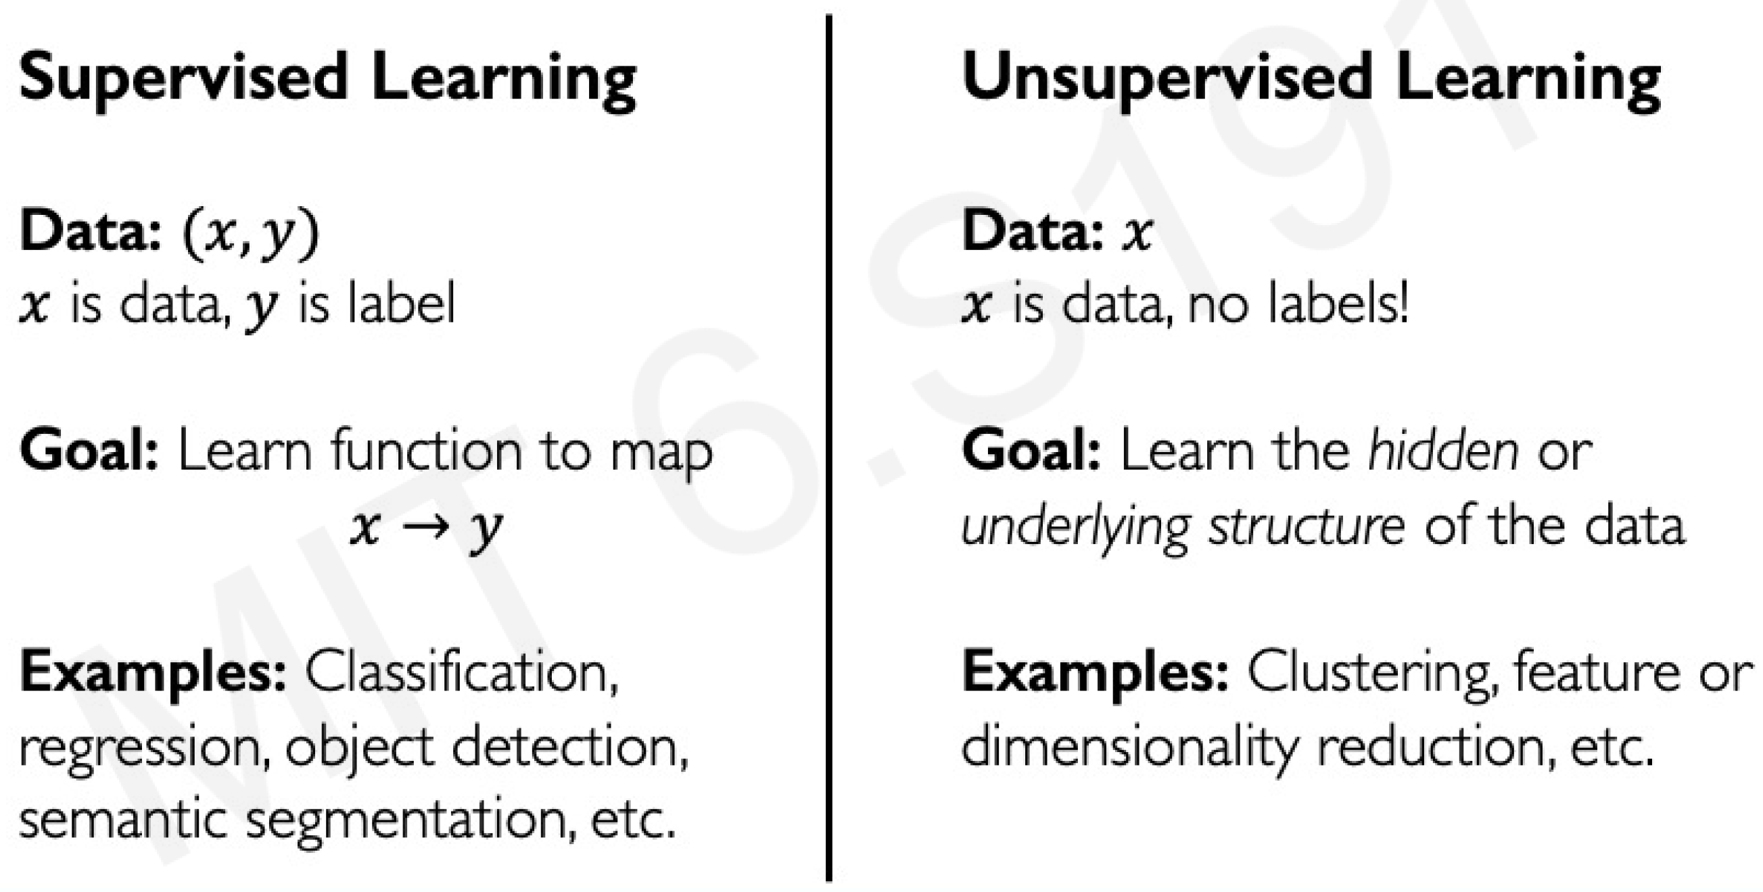
Supervised vs Unsupervised

Slide 43
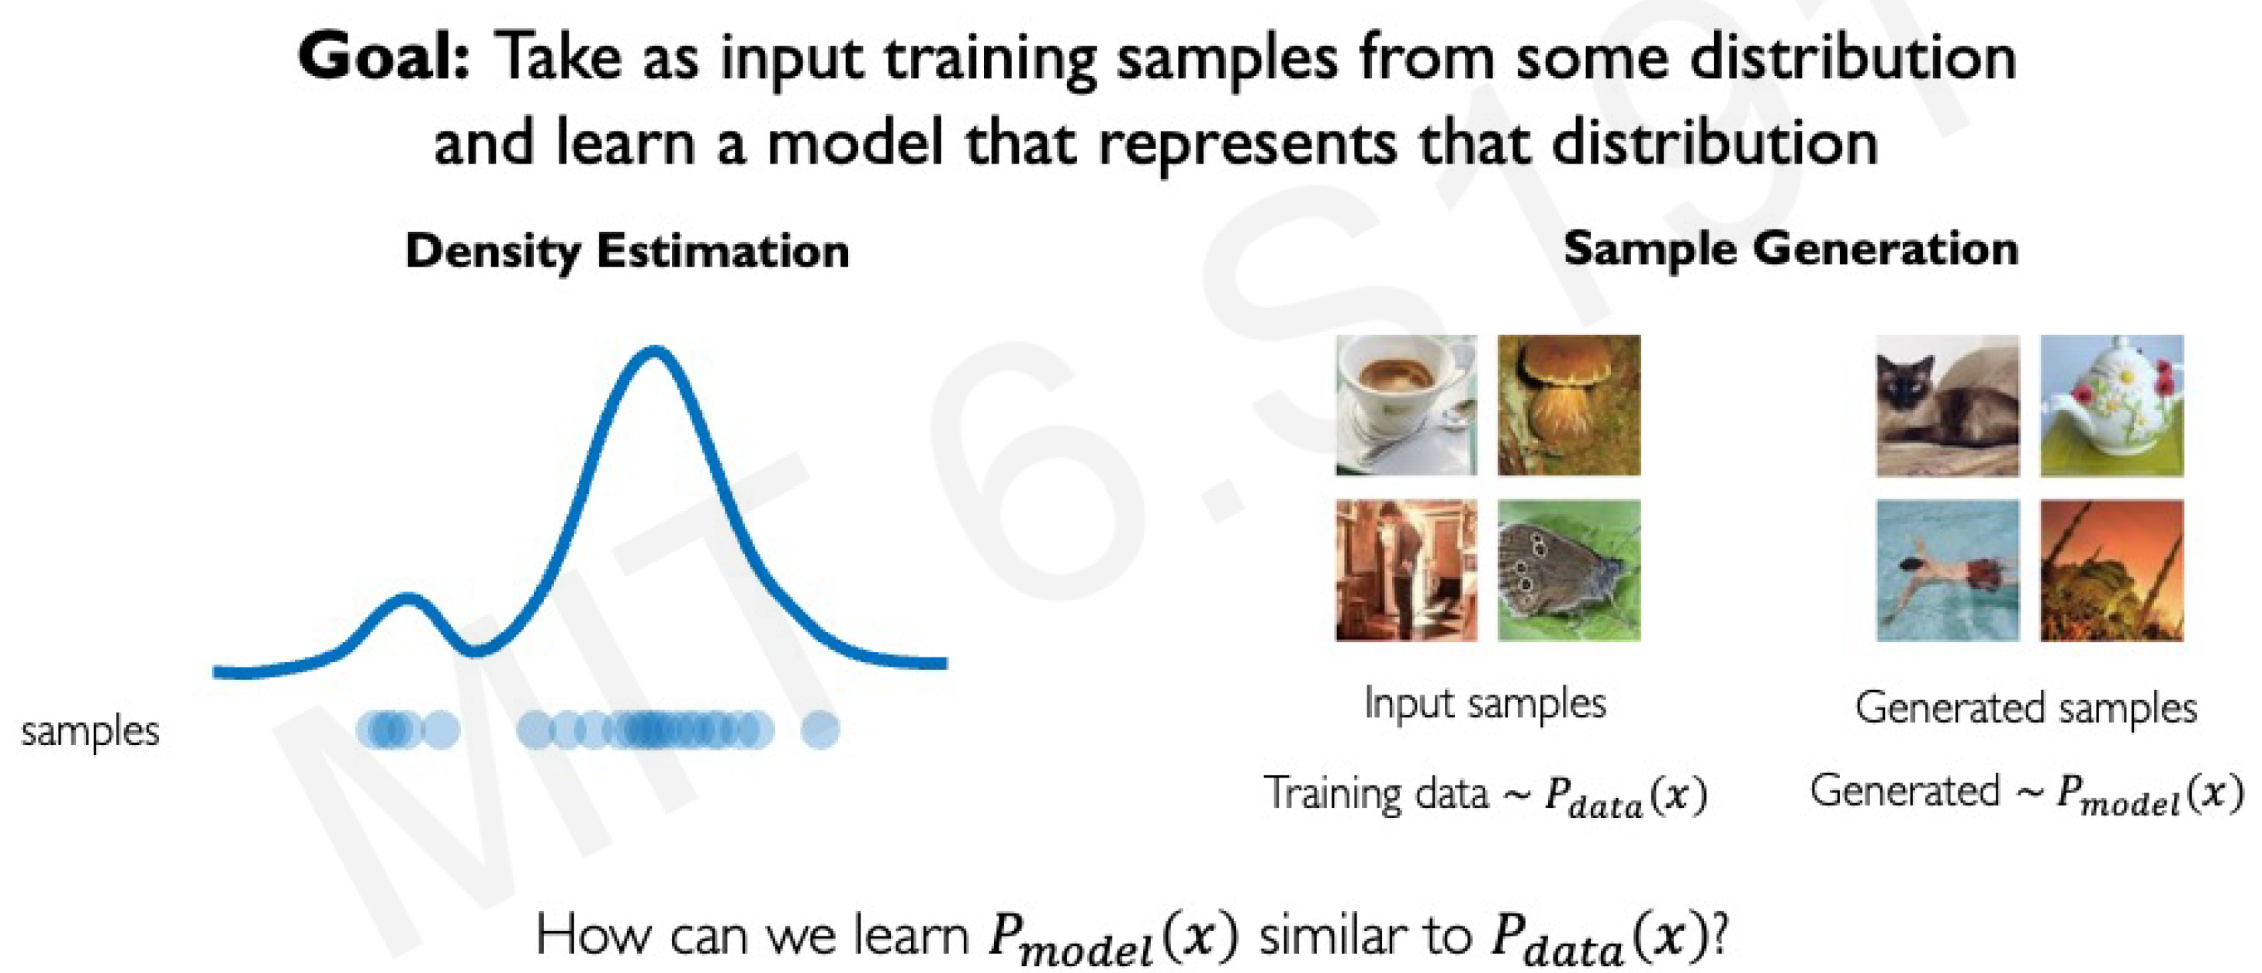
Generative Modeling

Slide 44
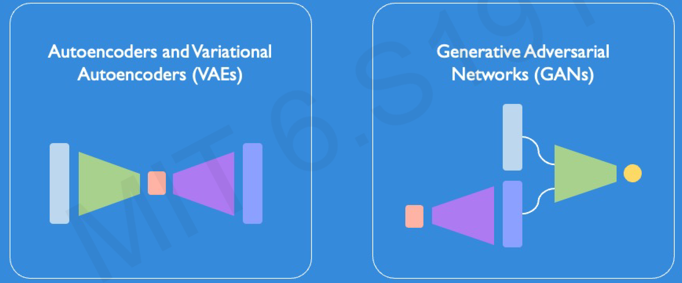
Latent Variable Models

Slide 45
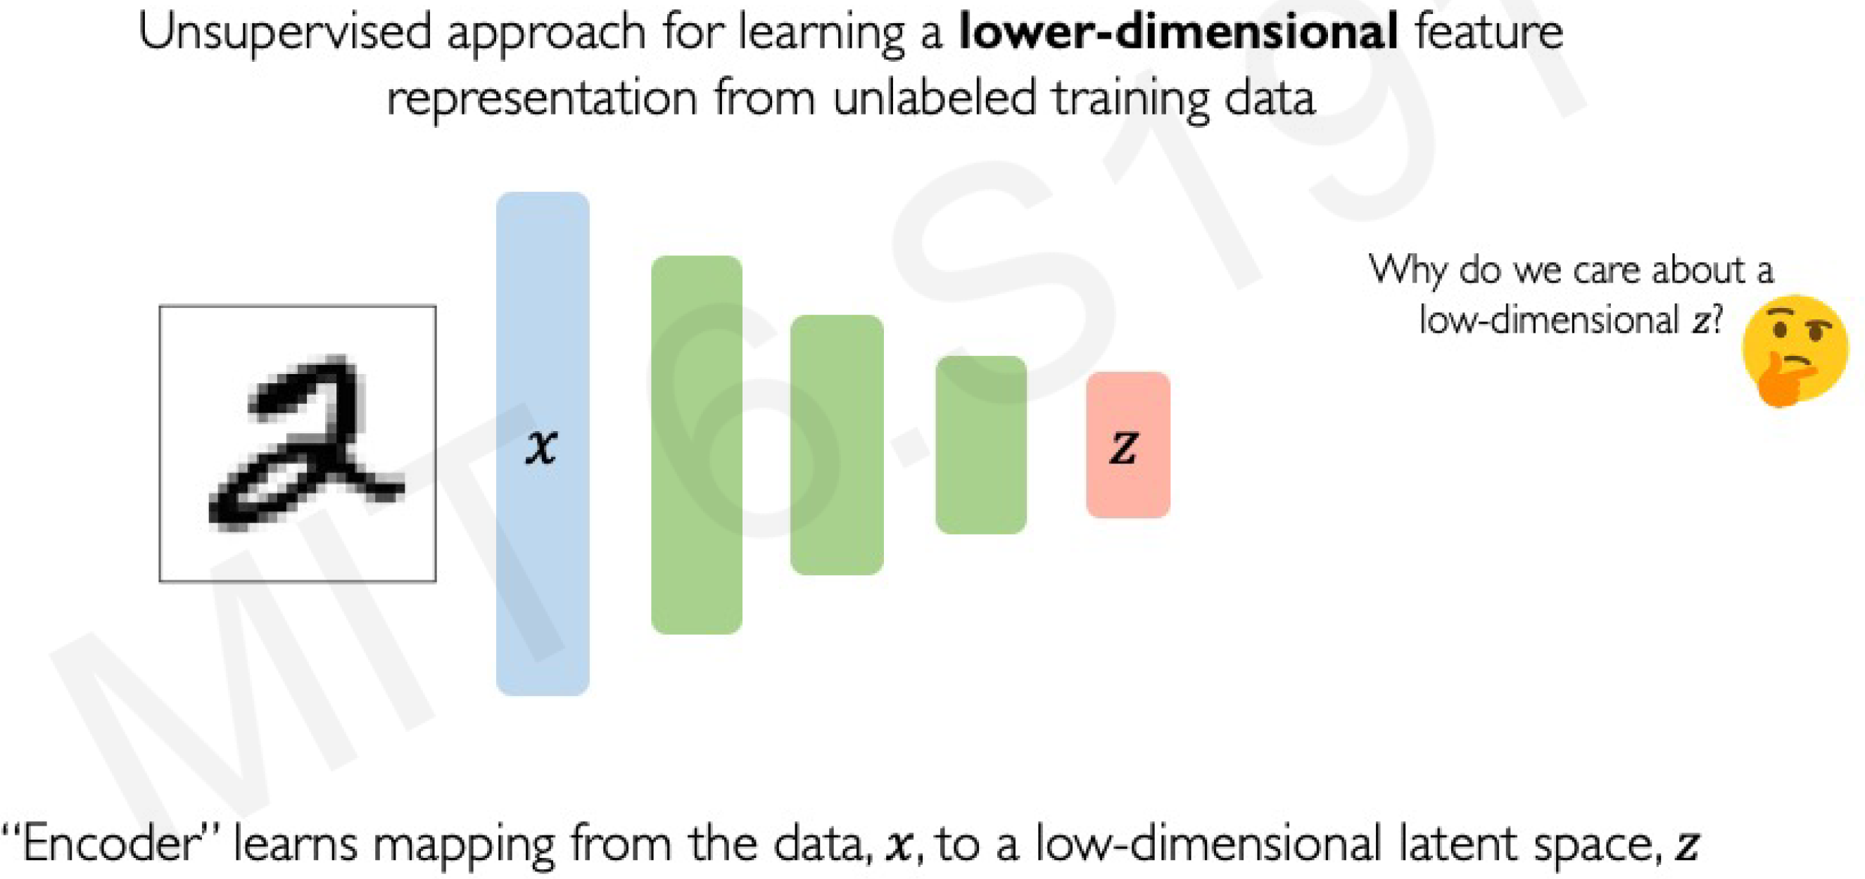
Autoencoders: Background

Slide 46
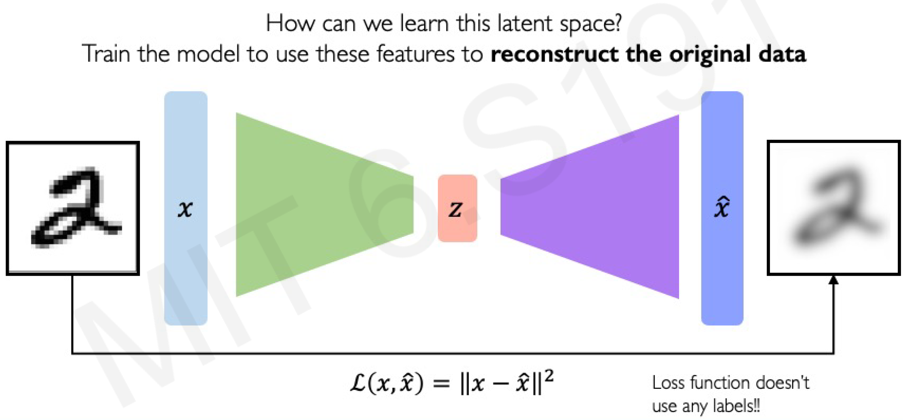
Autoencoders: Background

Slide 47
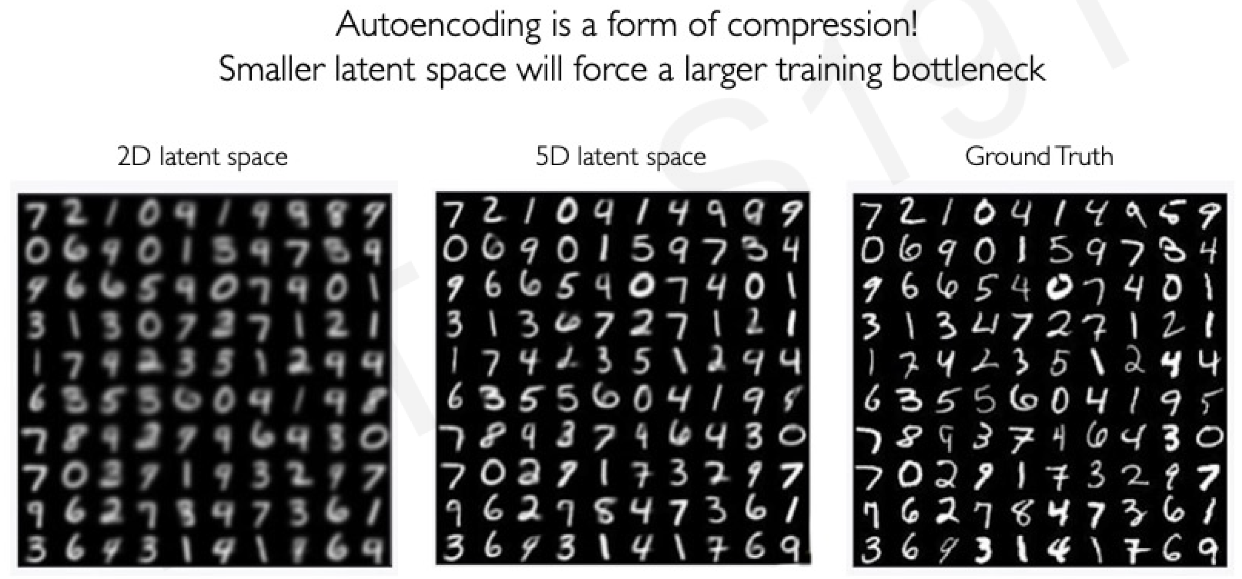
Dimensionality of Latent Space -> Reconstruction Quality

Slide 48
Variational Autoencoder (VAE)

Slide 49
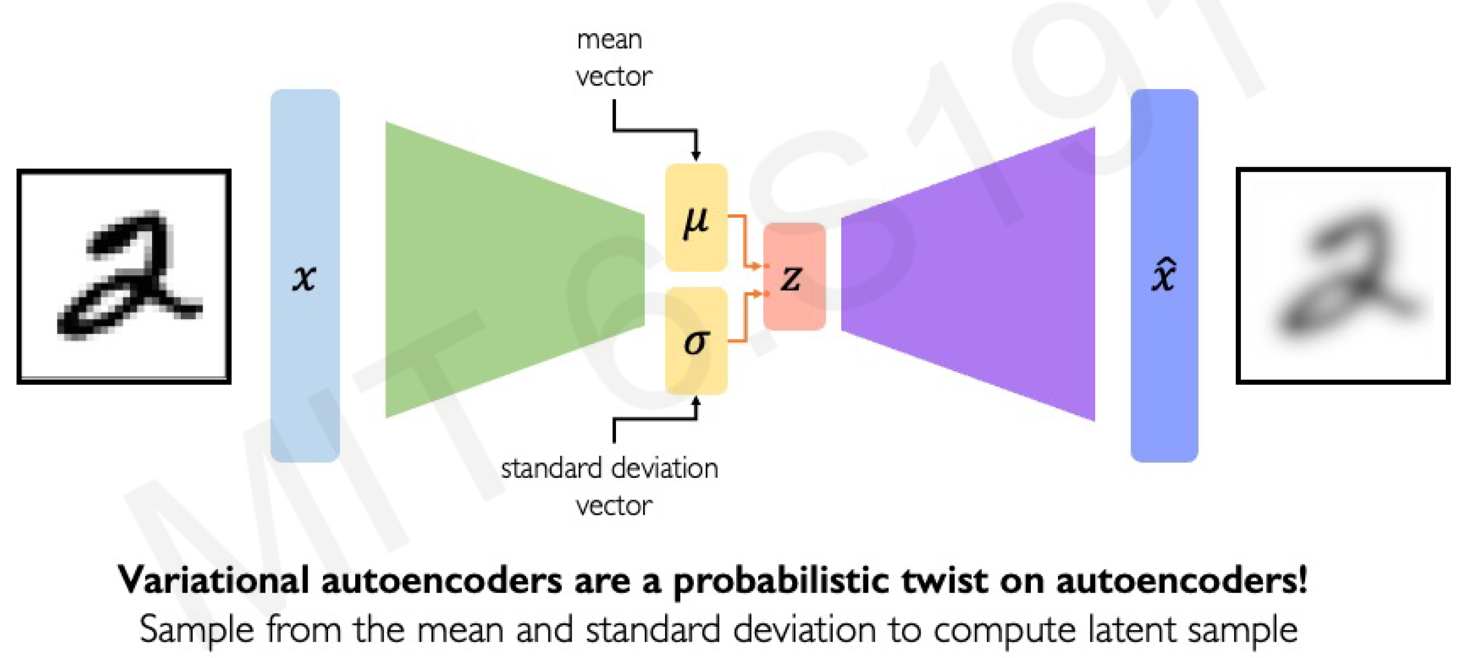
VAEs: Key Difference with Traditional Autoencoder

Slide 50
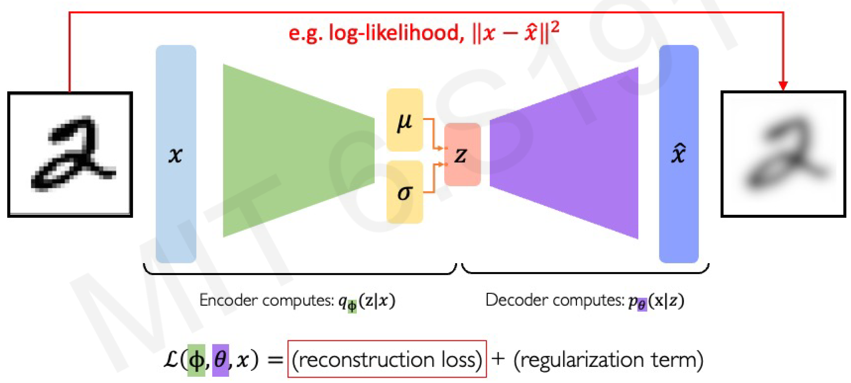
VAE Optimization

Slide 51
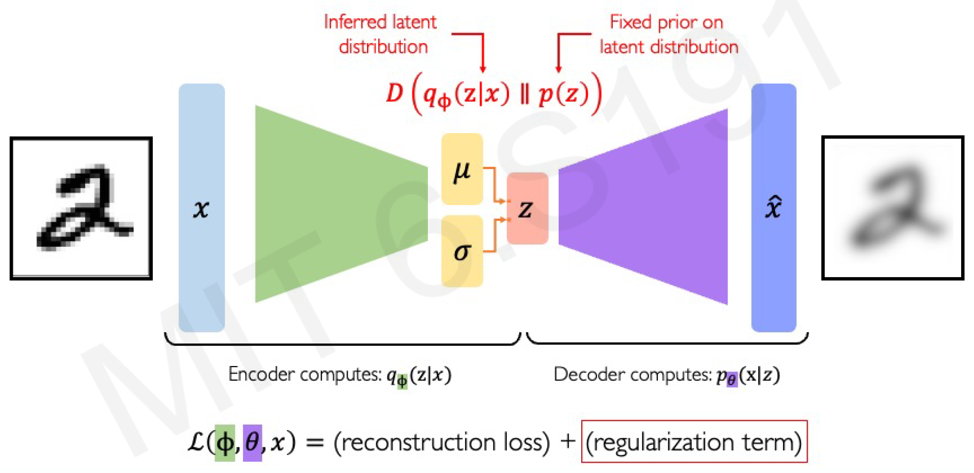
VAE Optimization

Slide 52
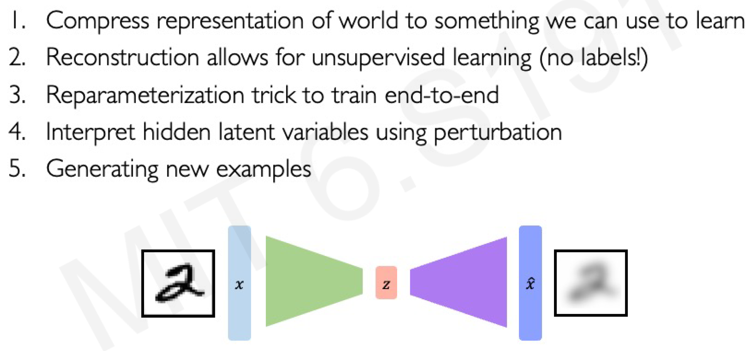
VAE Summary

Slide 53
Generative Adversarial Network (GAN)

Slide 54
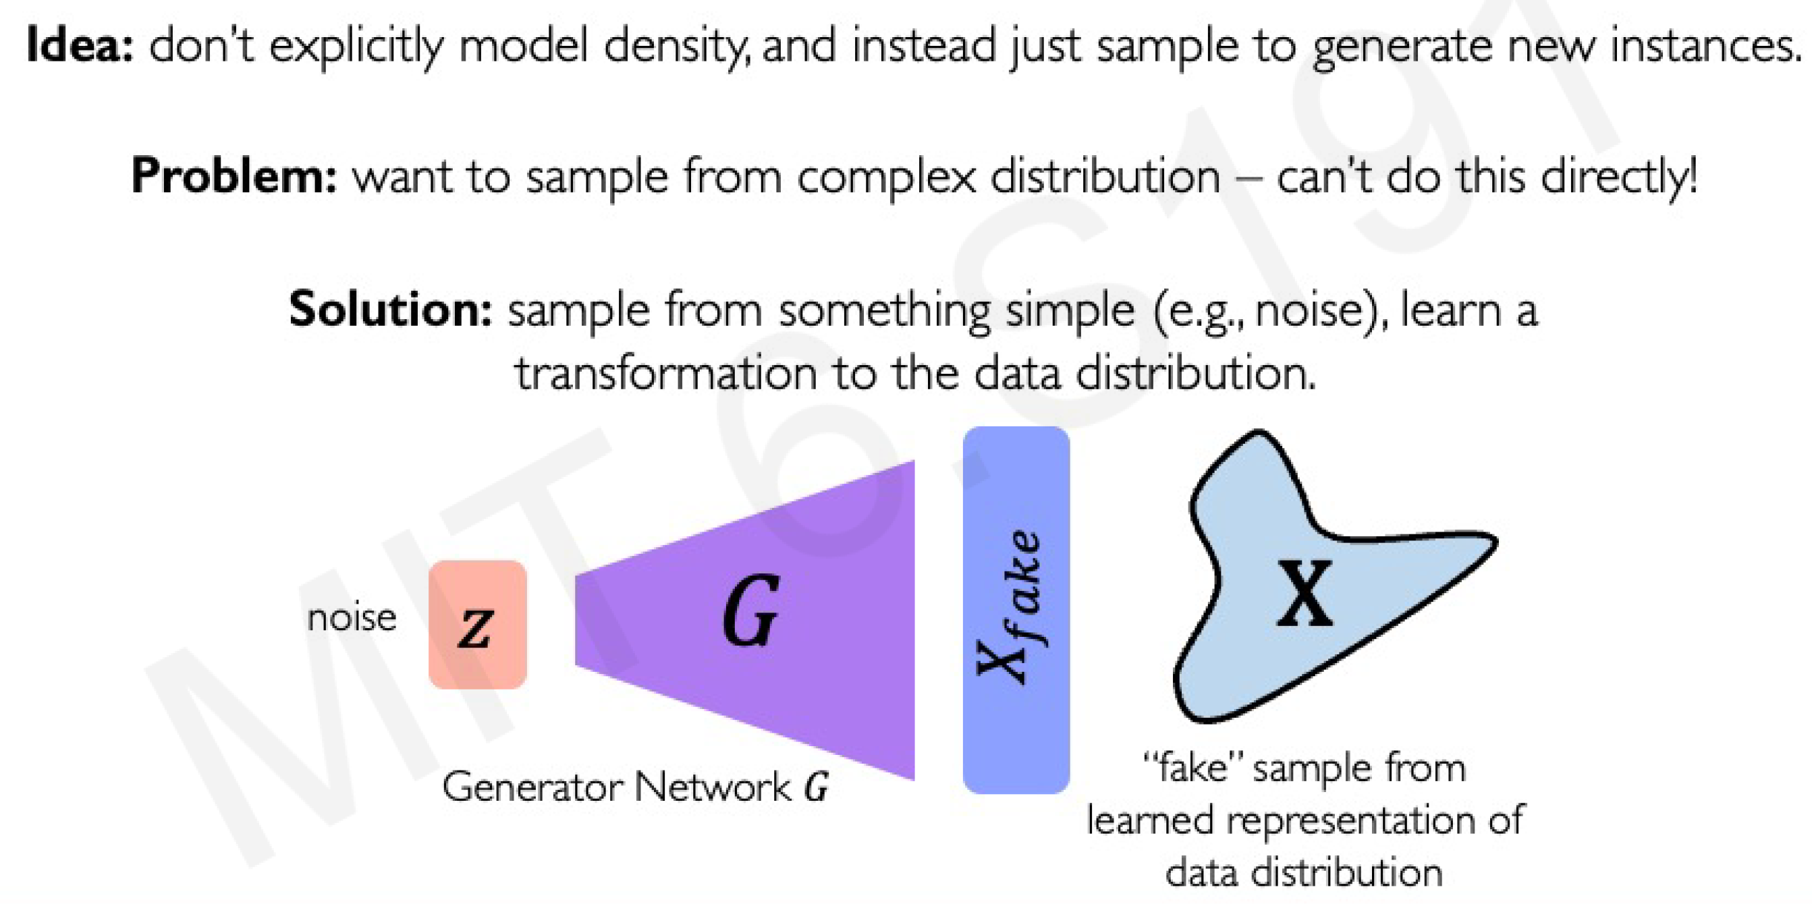
What if we Just Want to Sample?

Slide 55
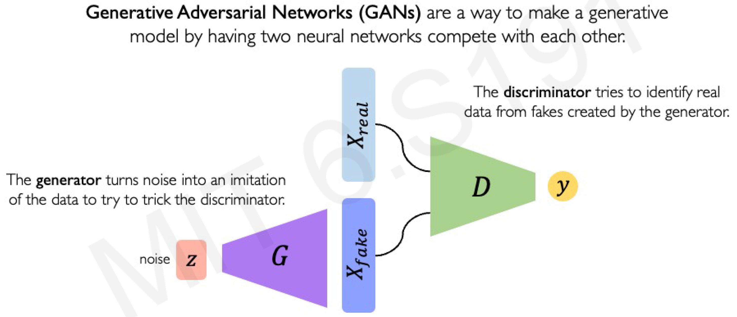
Generative Adversarial Network (GAN)

Slide 56

Training GANs

Slide 57

Training GANs: Loss Function

Slide 58

GANs are Distribution Transformers

Slide 59

Conditional GANs

Slide 60

Deep Generative Modeling Summary

Slide 61

Diffusion Models

Slide 62

The Diffusion Process

Slide 63




Diffusion Models
63
https://www.assemblyai.com/blog/diffusion-models-for-machine-learning-introduction/

Slide 64

Recurrent Neural Networks

Slide 65

Recurrent Neural Networks
65
https://leonardoaraujosantos.gitbooks.io/artificial-inteligence/content/recurrent_neural_networks.html

Slide 66

https://blogs.nvidia.com/blog/2016/08/22/difference-deep-learning-training-inference-ai/

Slide 67


Traditional vs ML problem solving
67

Slide 68

Neural Networks Limitations

